Slide 1
Funded by the Erasmus + Programme of the European Union
Latvia

Slide 2
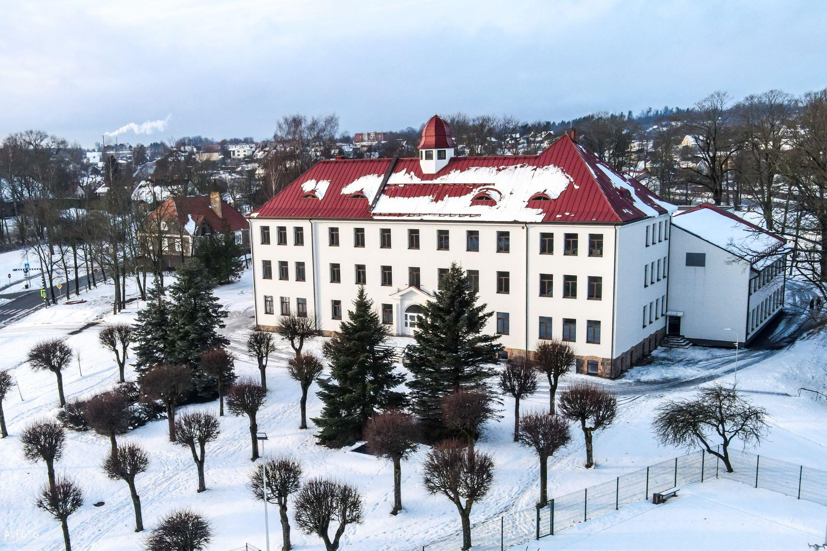
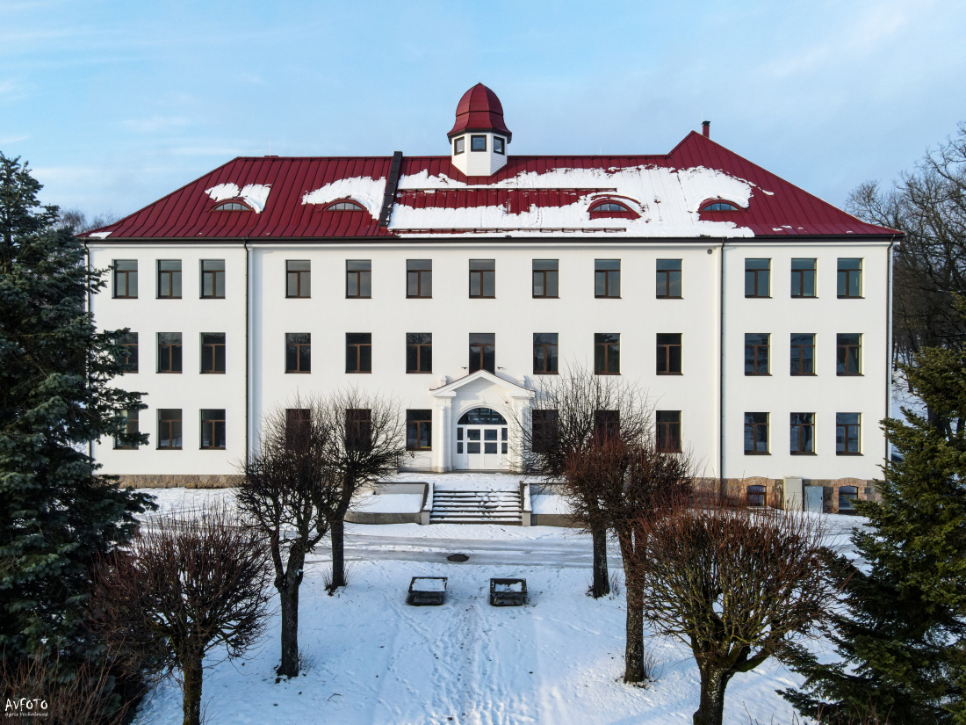
Madona State Gymnasium

Slide 3
01
History of school
02
Numbers
03
Uniform and symbols
04
School council
05
Traditions

Slide 4
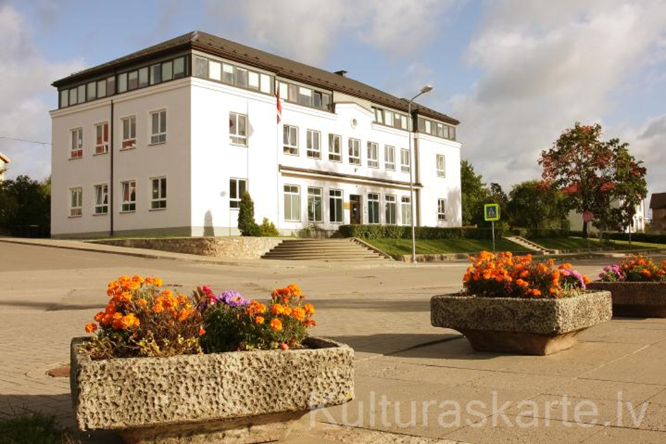
HISTORY OF THE GYMNASIUM
Madona Gymnasium started in 1908.
From 1921 to 2003 it was called Madona City Gymnasium.
In 2003 got State Gymnasium status.
During 18 years students studied in 4 different buildings.
In February 2021 school was moved to a new building.

Slide 5
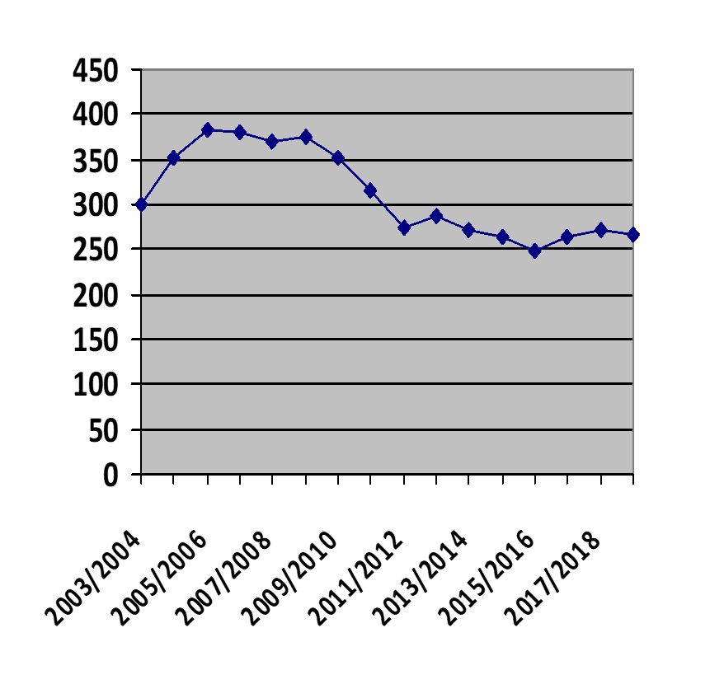
SCHOOL IN NUMBERS
Number of students through the years
Students- 260
Teachers- 40
7th to 12th grade
This year’s colour- turquoise blue

Slide 6
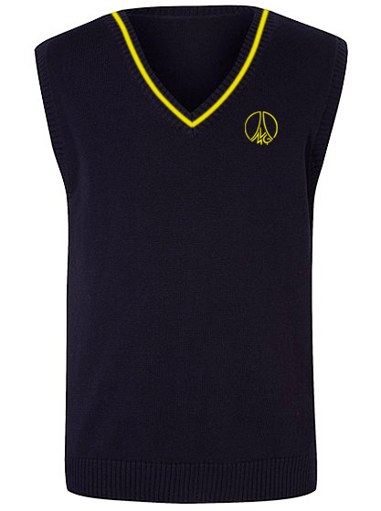
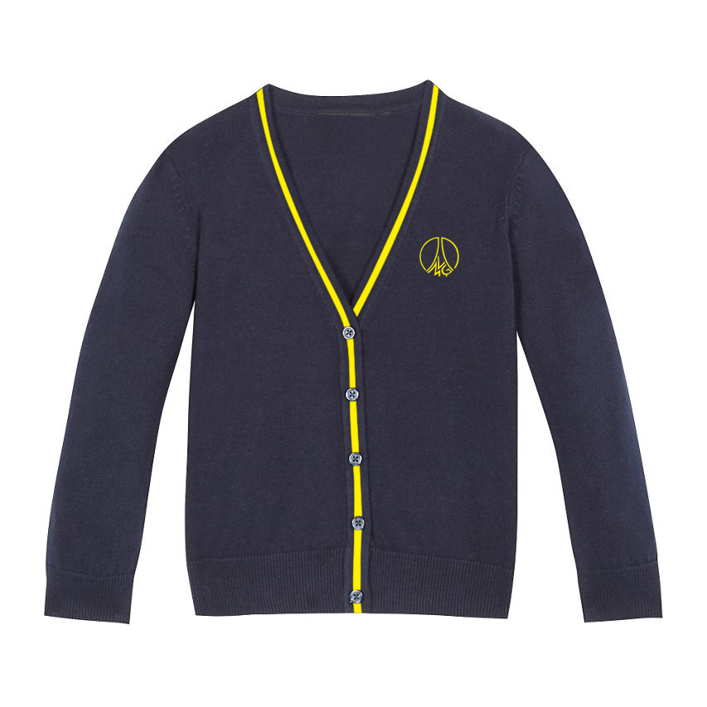
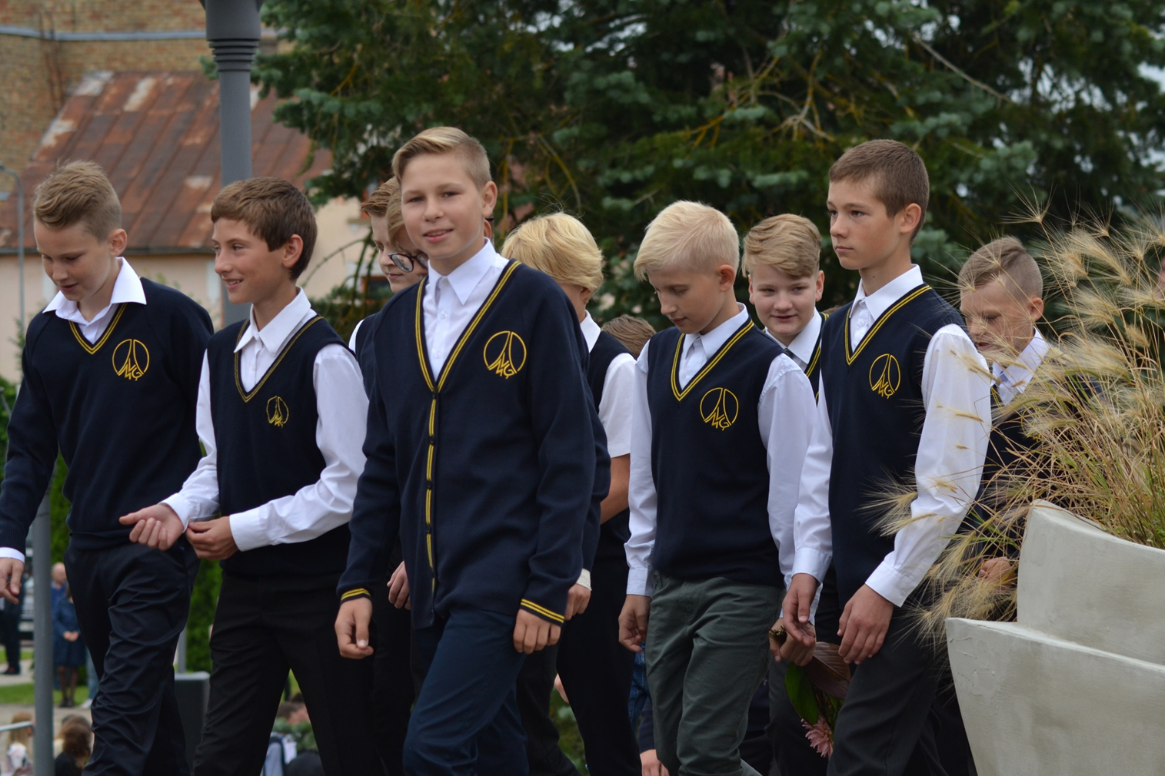
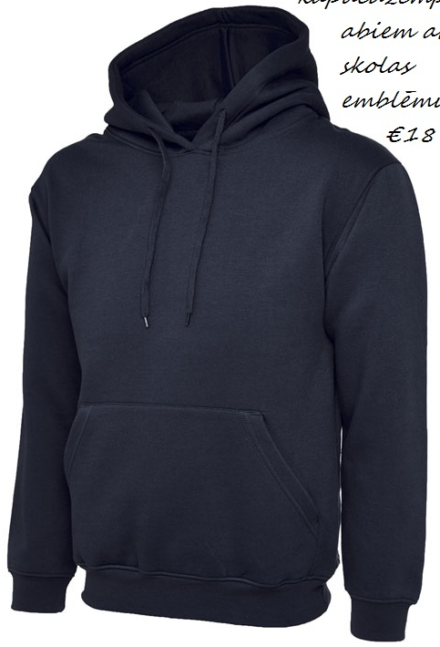
SCHOOL UNIFORMS

Slide 7
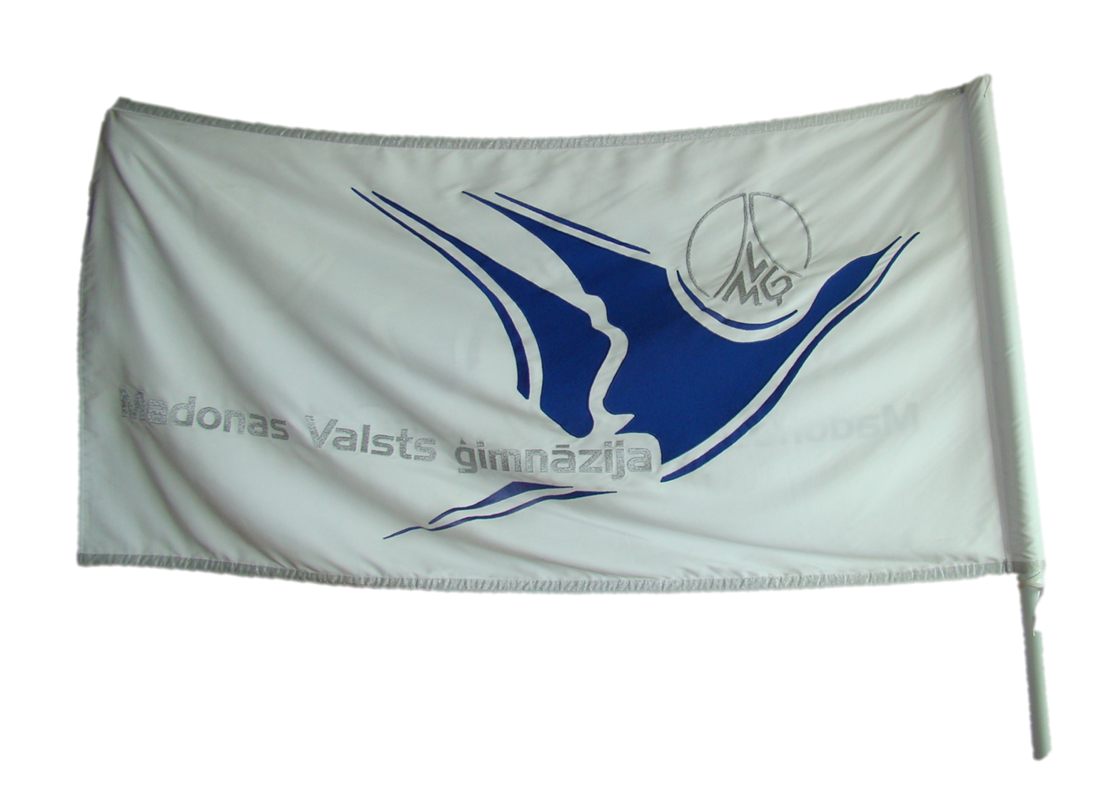
SCHOOL SYMBOLS
flag
logo

Slide 8
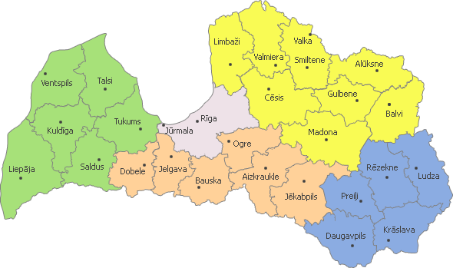
OUR LOCATION

Slide 10
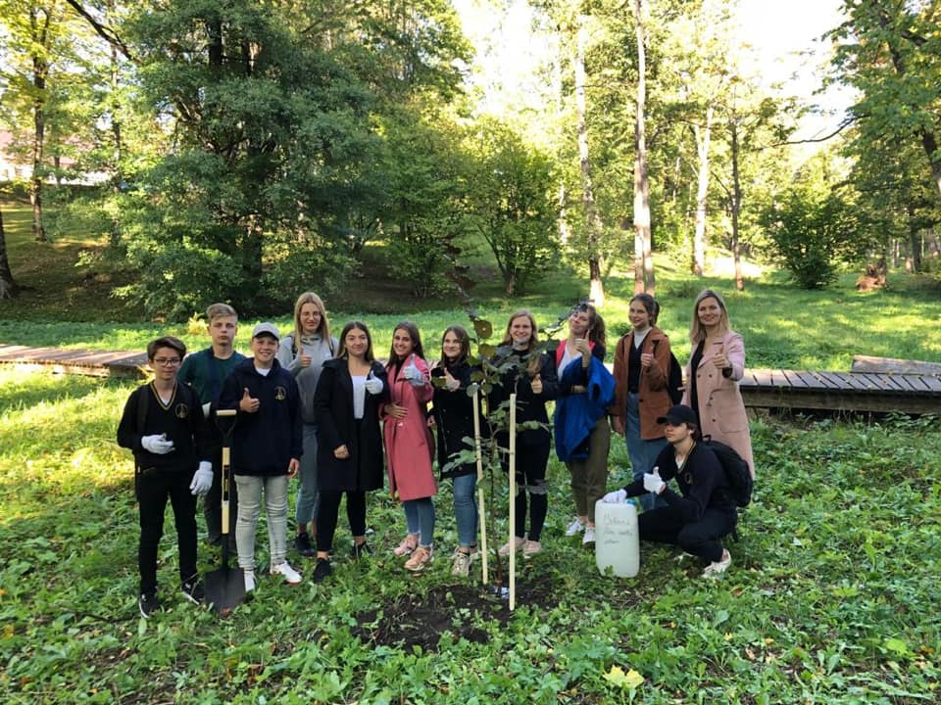
STUDENT COUNCIL

Slide 11
THINK
SOLVE PROBLEMS
LISTEN
WHAT WE DO?
ENTERTAIN
HELP
We think about the ways how to solve problems, and how to make school life more pleasant.
We solve problems that are related to students’ feelings and their needs.
We listen to students.
Organise concerts and other events.
It is our job to help others.

Slide 12
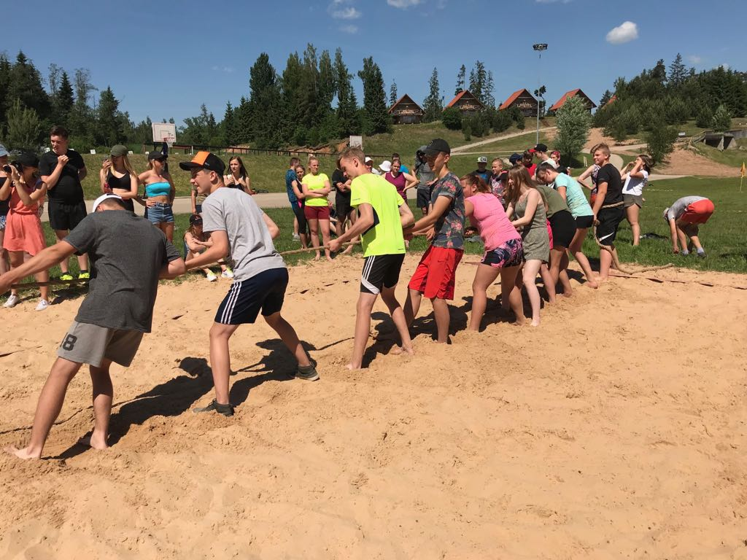
TRADITIONS
Our school has a lot of different traditions.

Slide 13
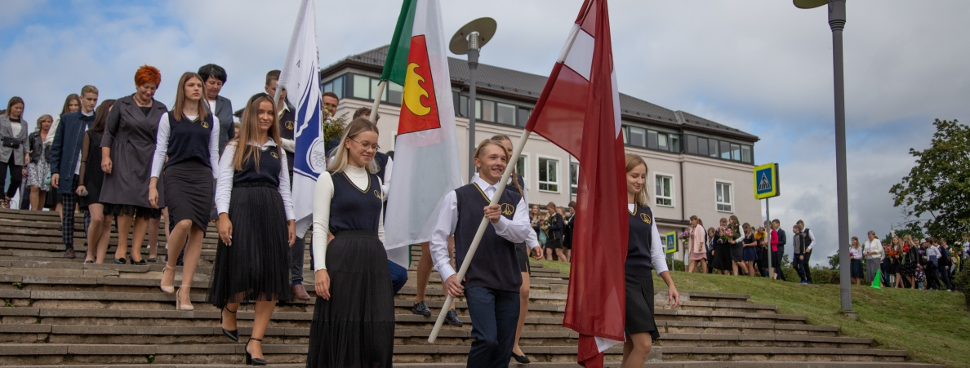
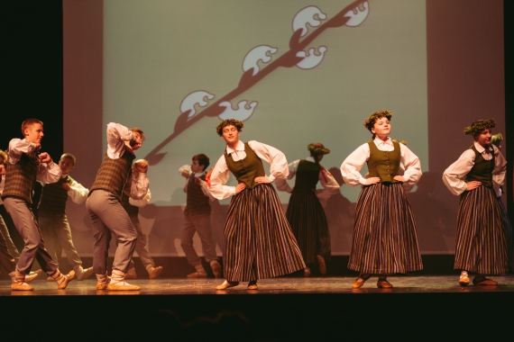
FIRST SCHOOL DAY
TEACHER’S DAY
LATVIA’S BIRTHDAY - 18TH NOVEMBER
On this day we all get together to start a new school year.
Students prepare a short concert for the teachers.
Usually students prepare performances.

Slide 14
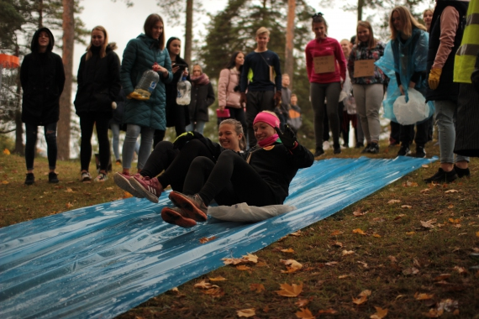
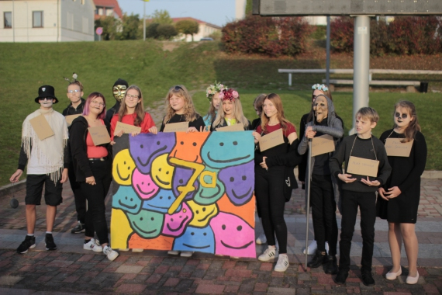
FRESHERS
New students become real members of the school.

Slide 15
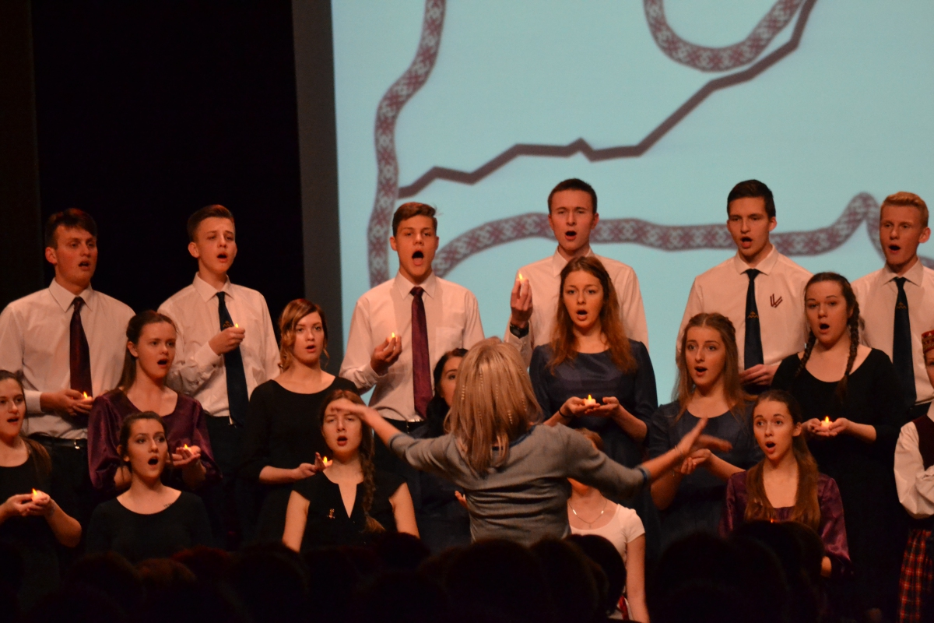
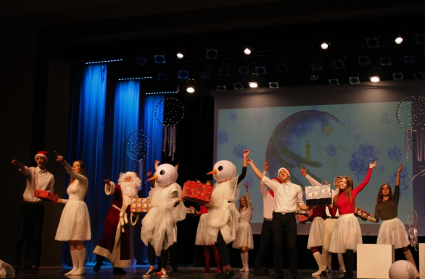
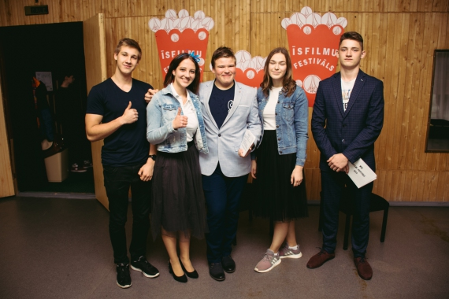
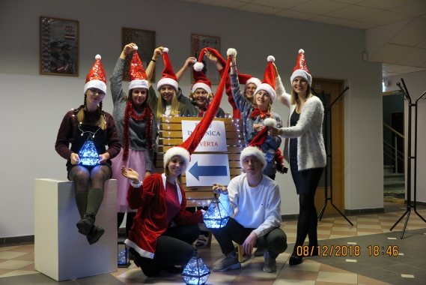
CHRISTMAS CONCERT
MERCURY
VENUS
SATURN
CHOIR CONTEST
CHRISTMAS CONCERT
Despite being red, Mars is a cold place, not hot. It’s full of iron oxide dust
Mercury is the closest planet to the Sun and the smallest one in the Solar System
Venus has a beautiful name and is the second planet from the Sun
Saturn is the ringed planet. It’s a gas giant, composed mostly of hydrogen and helium
SHORT FILM FESTIVAL
CHRISTMAS MAIL

Slide 16
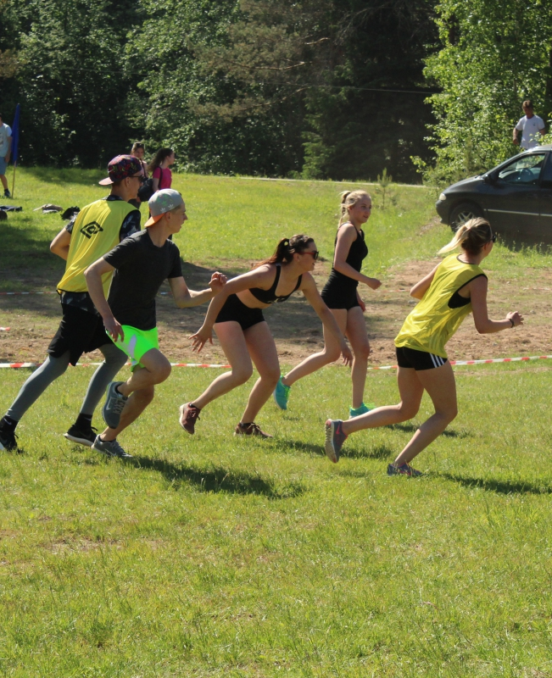
SPORTS EVENTS
OLYMPIC DAY
“AMAZING RACE”

Slide 17
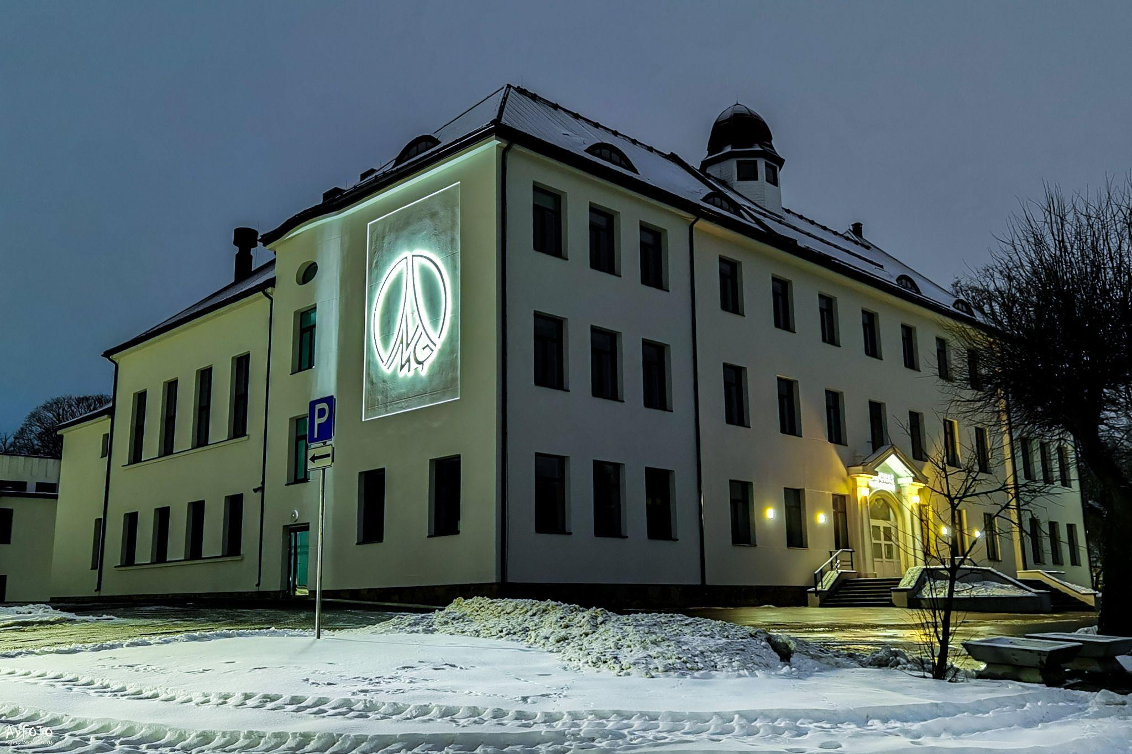
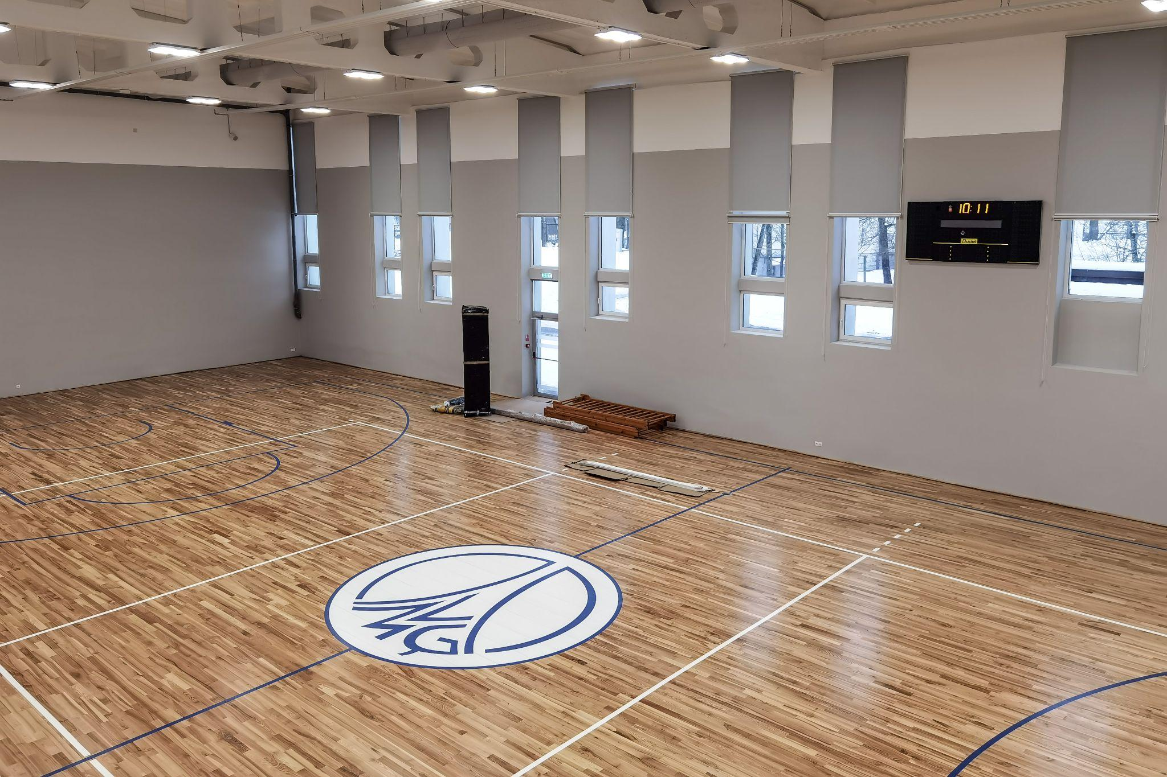
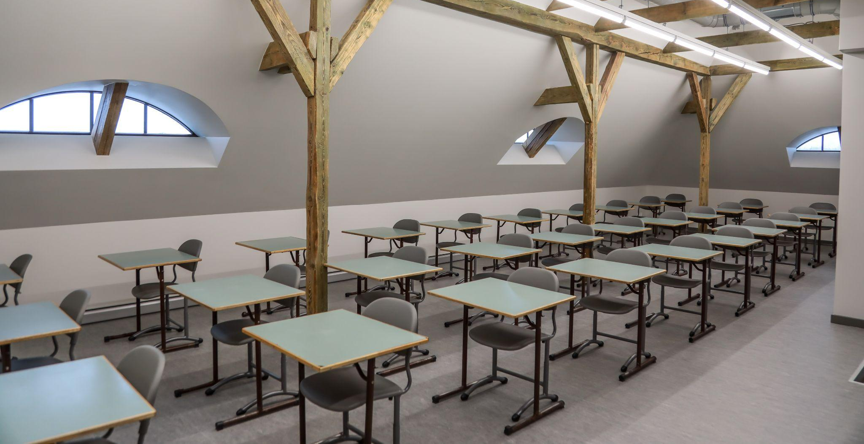
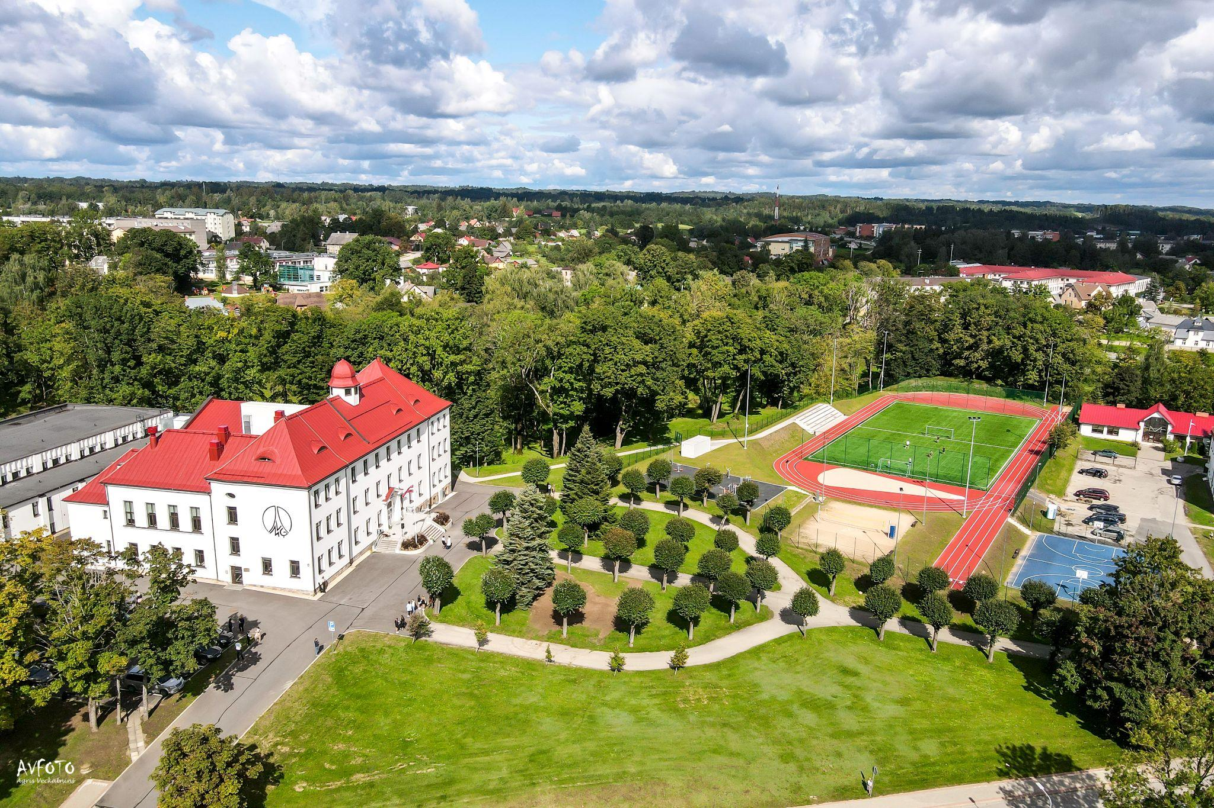
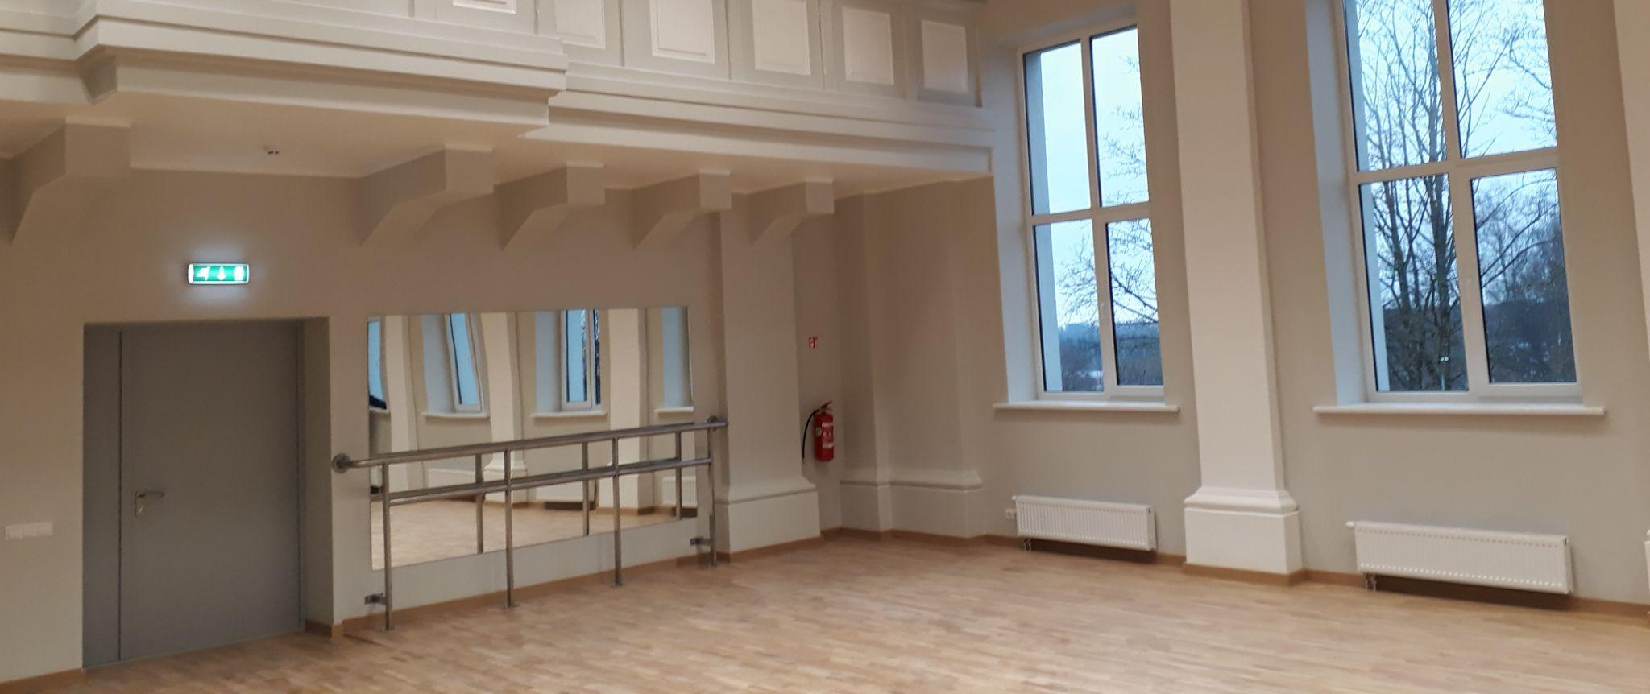
Our thoughts about school

Slide 18
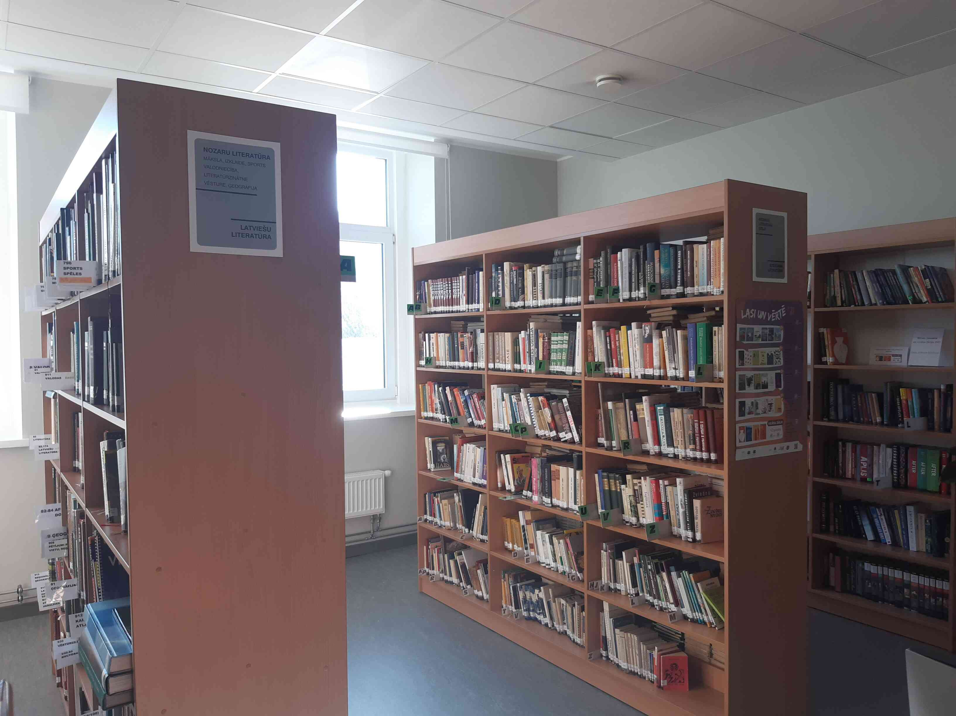

Slide 19
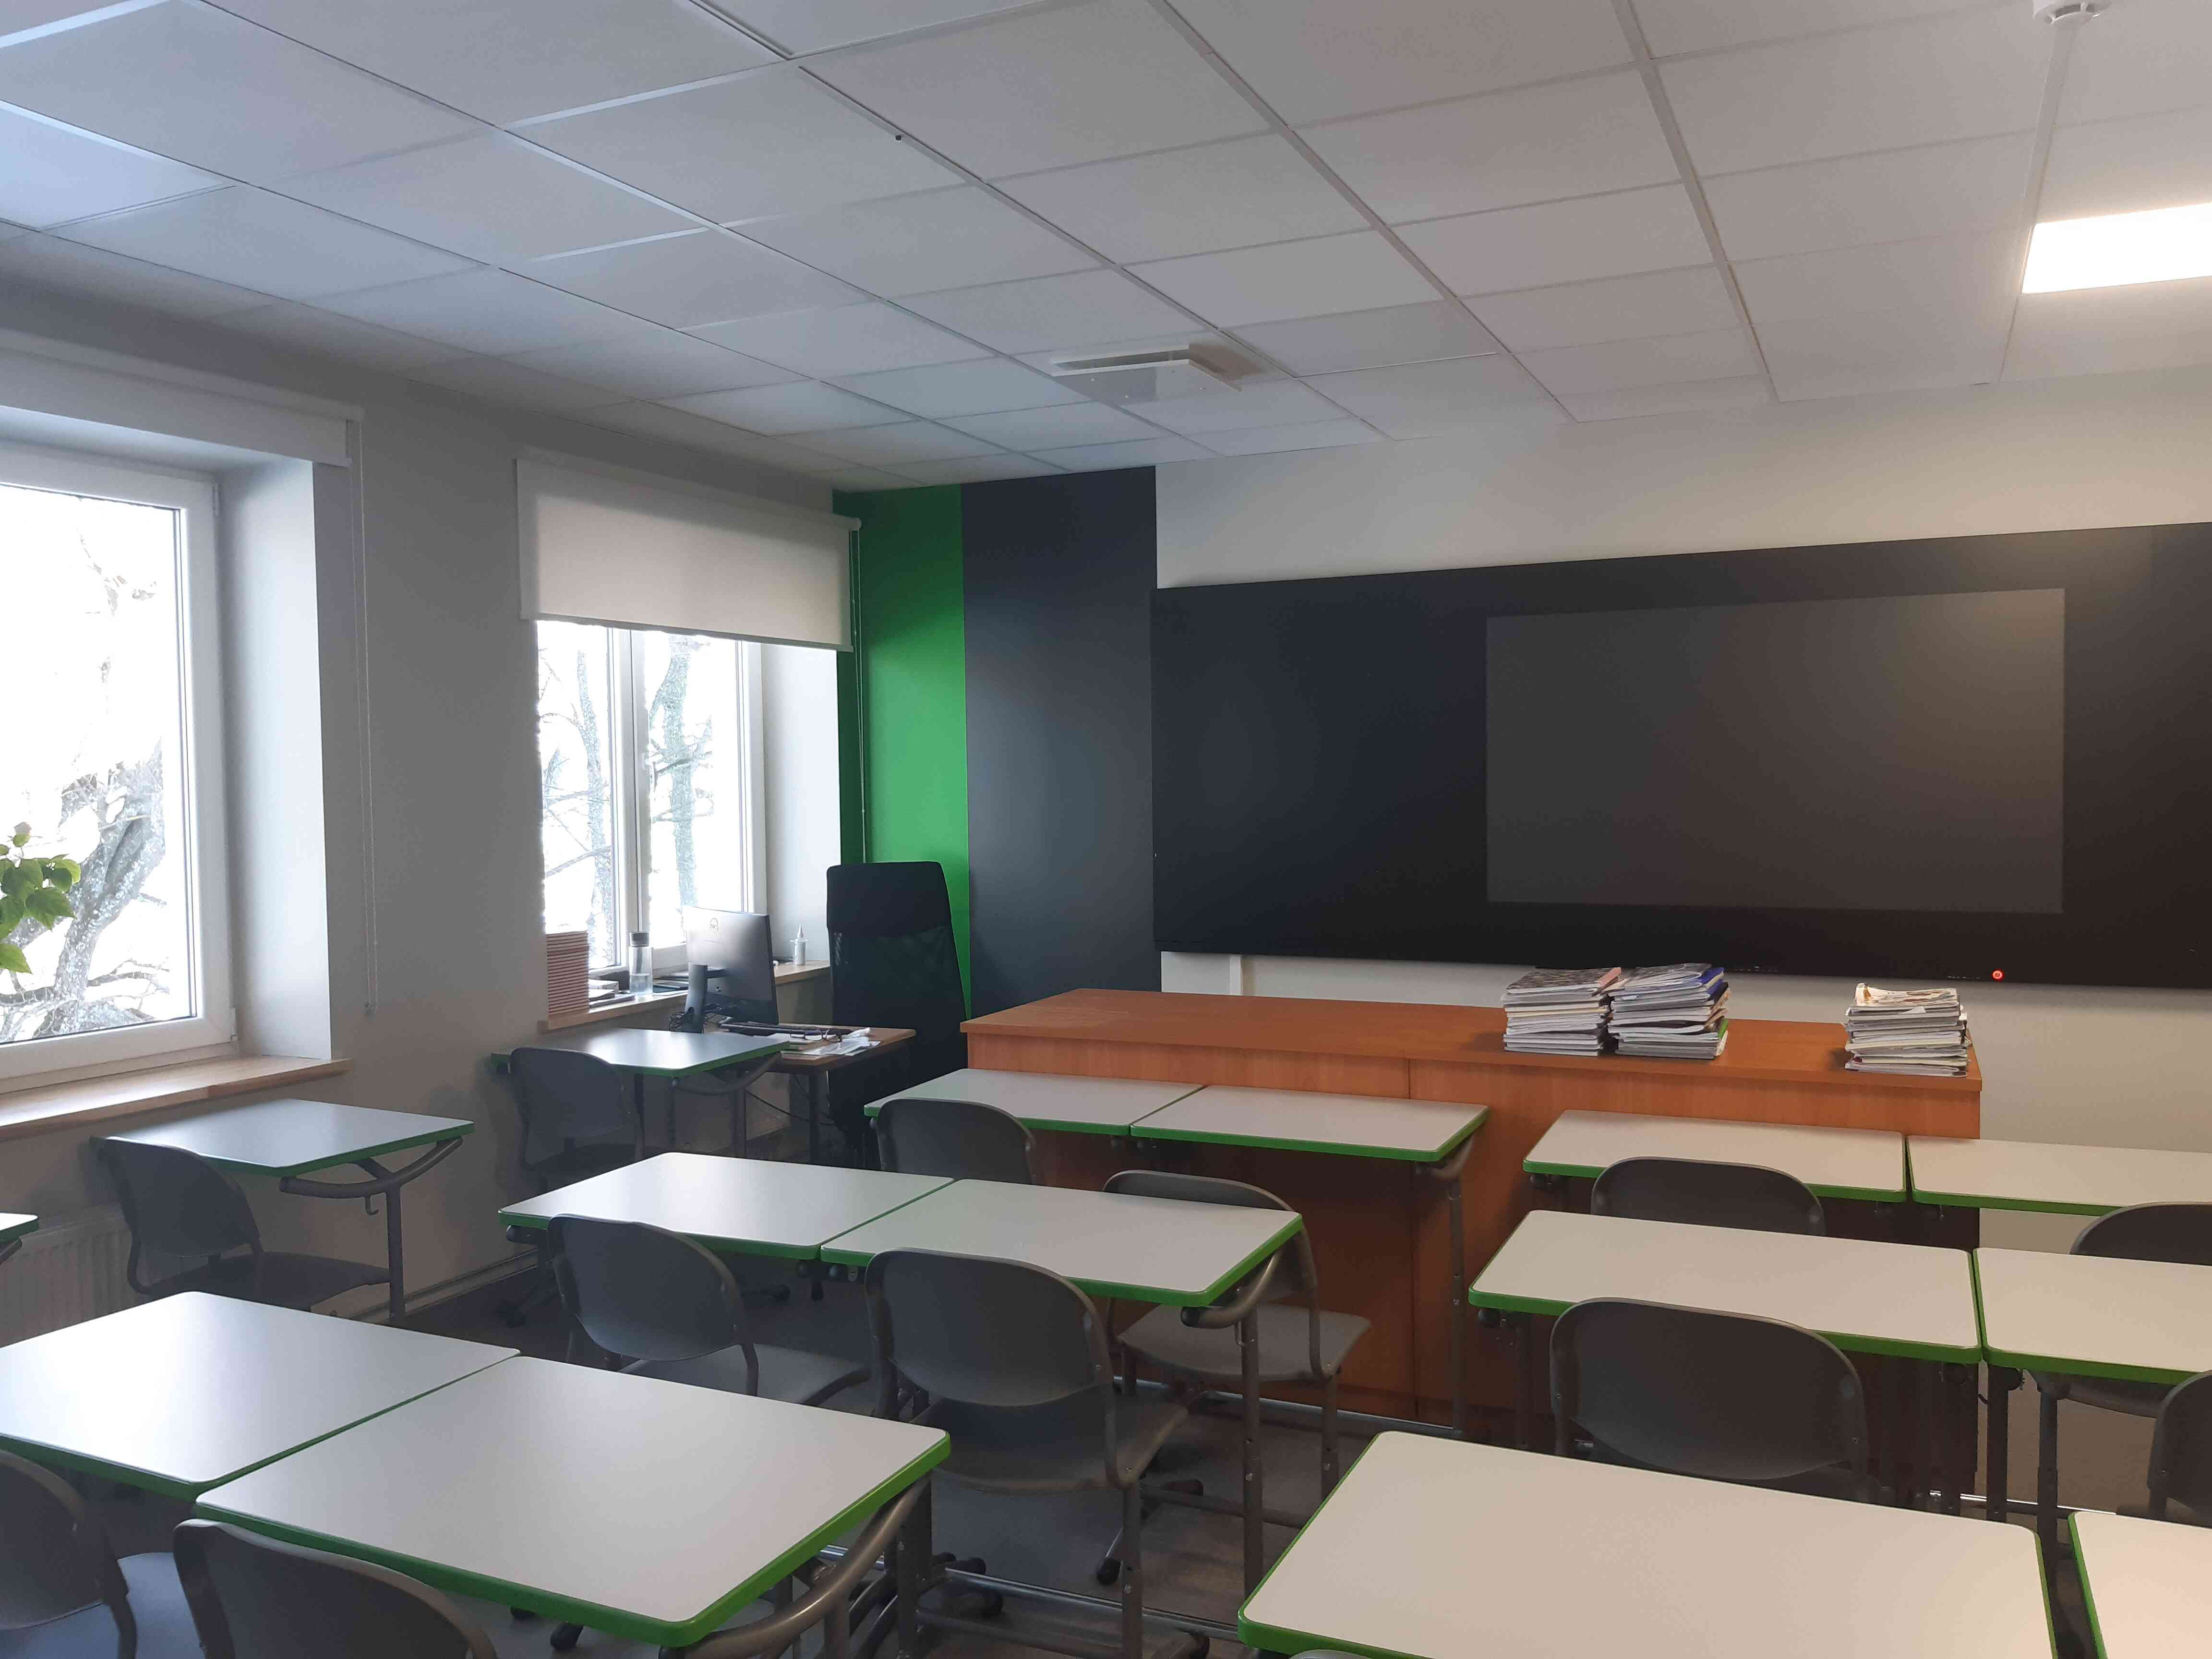

Slide 20
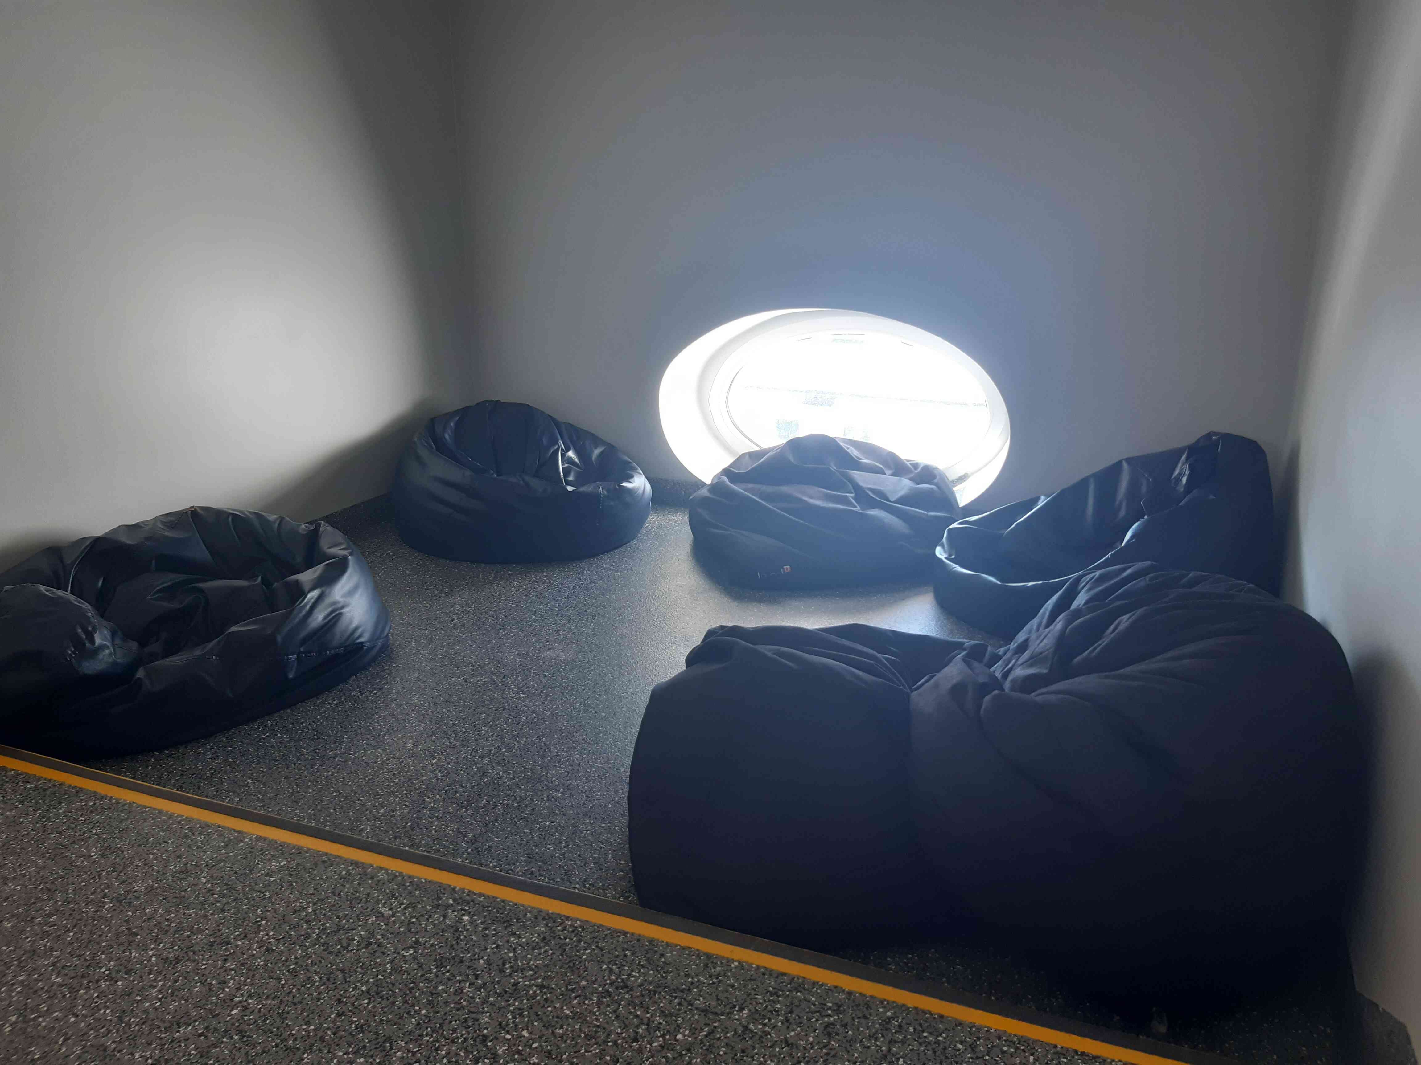

Slide 21
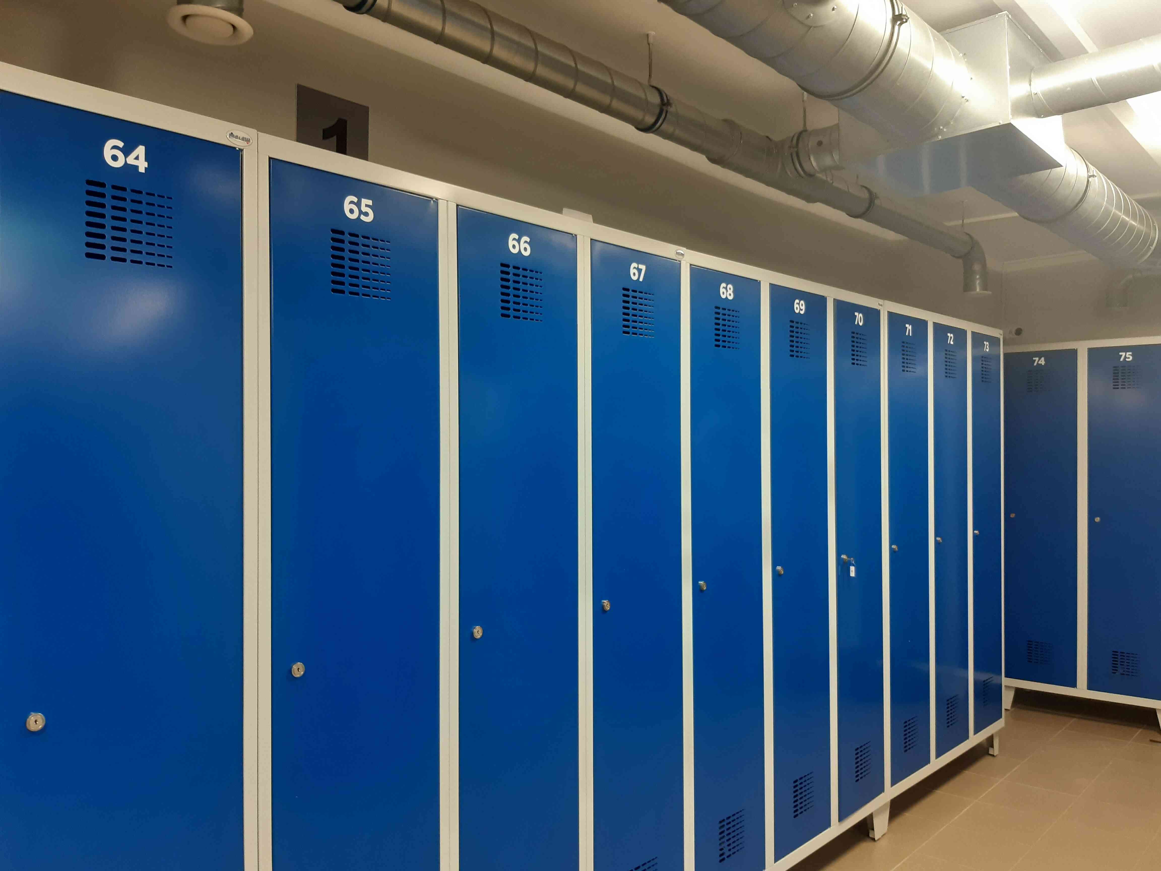

Slide 22
THANK YOU FOR YOUR ATTENTION!!!

