Slide 1

PROJECT ERASMUS+
MADONA STATE GYMNASIUM
2016 - 2018

Slide 2

EL at school
Lessons of Economics (1 per week), class 10-12
Club of Young Entrepreneurers, class 7th-9th
Shadowing Day, lectures and seminars
Meetings with business people
Meetings with young entrepreneurers, former students of our school
Visiting different enterprises
Competitions in Economics

Slide 3
EL at school
Student companies
Working out short business plans
Summer camps
Participating in school, local, national and international fairs
JAL activities
Business game (‘TITAN’)
Exchanging experience with students from Estonia
Support by SSE, Riga Business School, Swedbank, SEB Bank, LIAA, Business Incubator, Local Authorities etc.
Project of Nordic countries

Slide 4






Slide 5
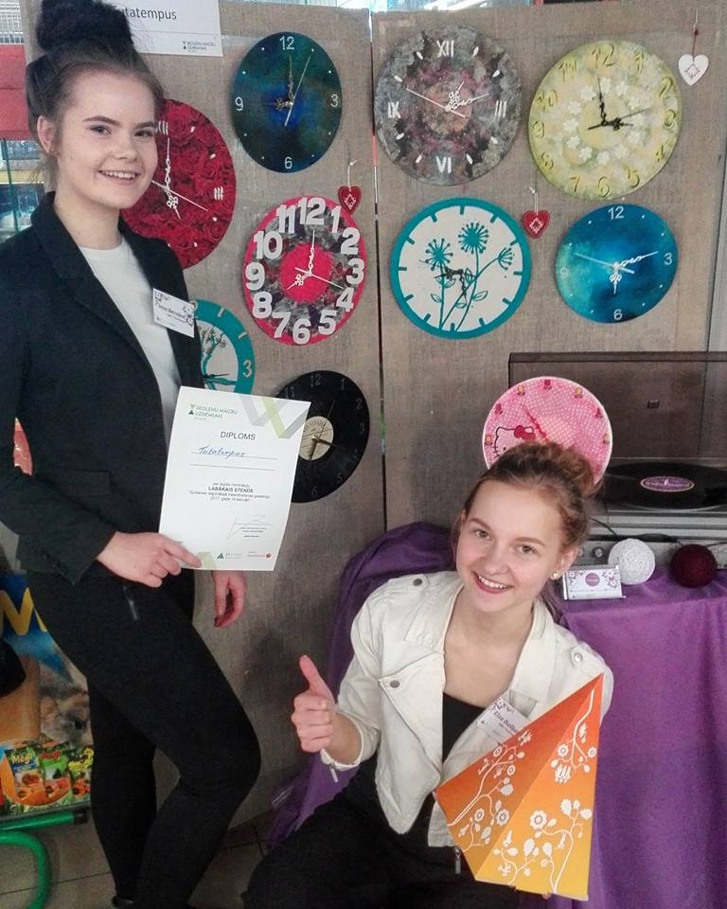
STUDENT COMPANY Tutatempus
Wall clocks out of vinyl
Three different designs
Best stand awards
Wall clocks out of vinyl
Three different designs
Best stand awards

Slide 6
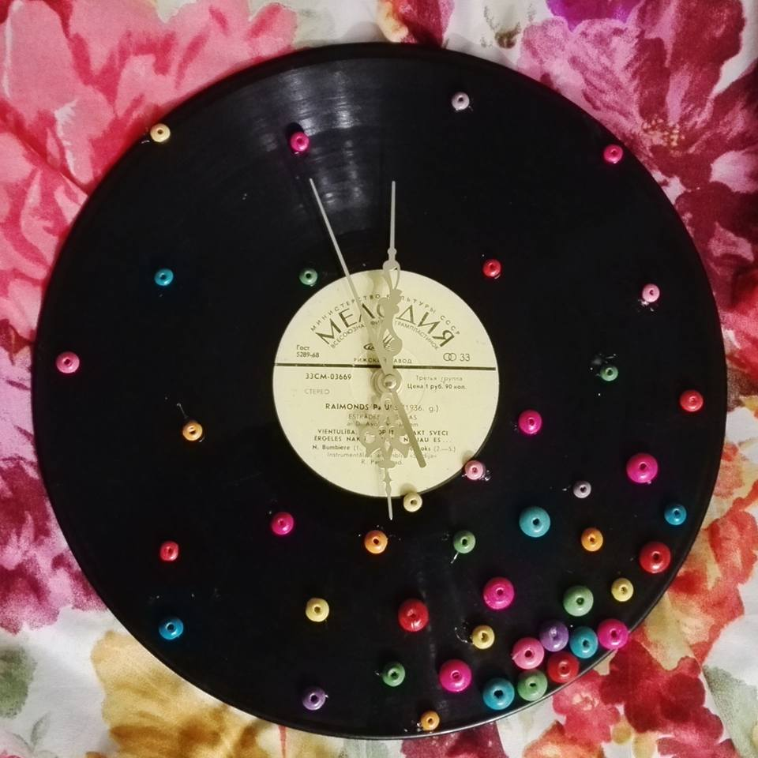
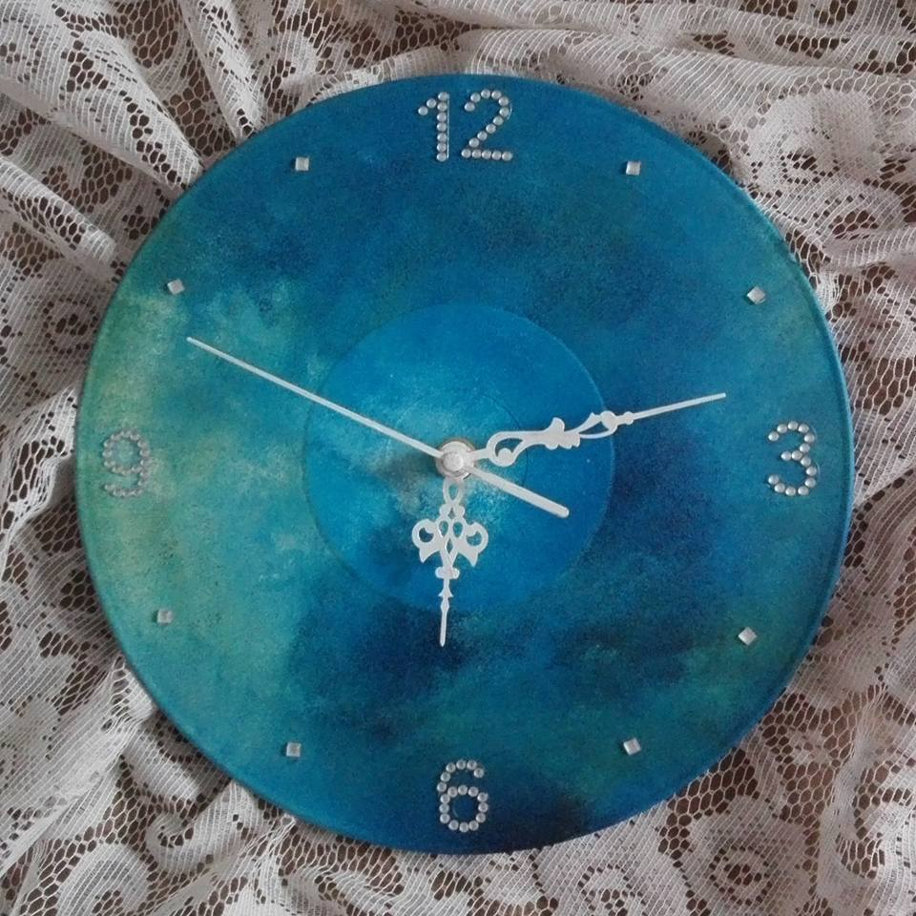

Tutatempus products

Slide 7
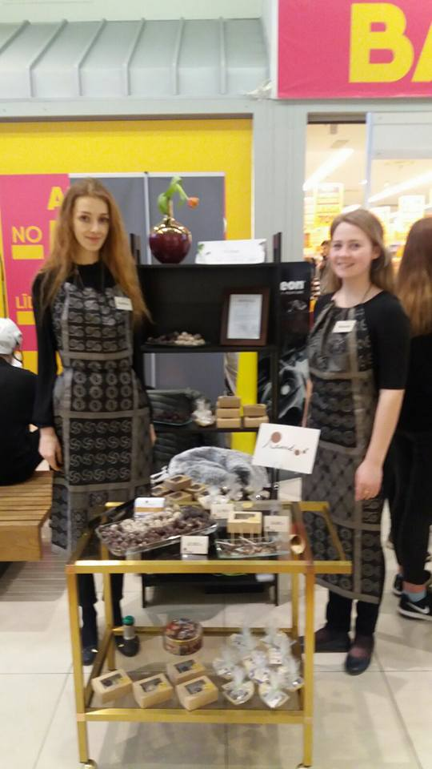
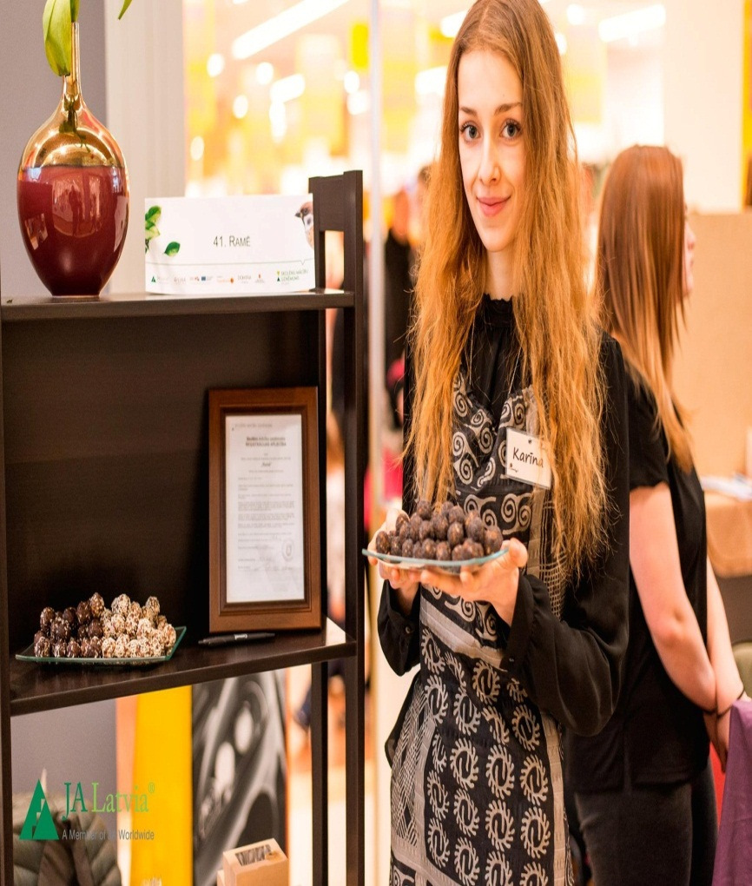
STUDENT COMPANY
Ramē
Healthy energy balls
Made from nuts, dried fruits and honey
Solution for busy and active people

Slide 8
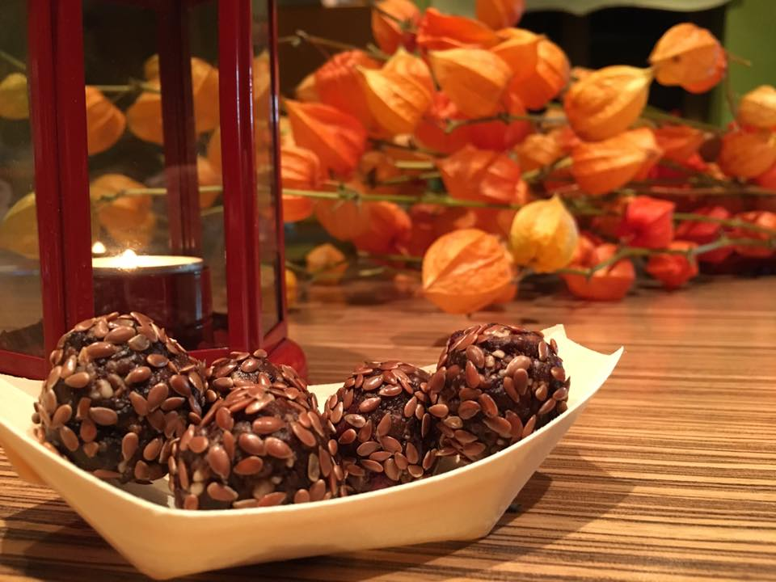
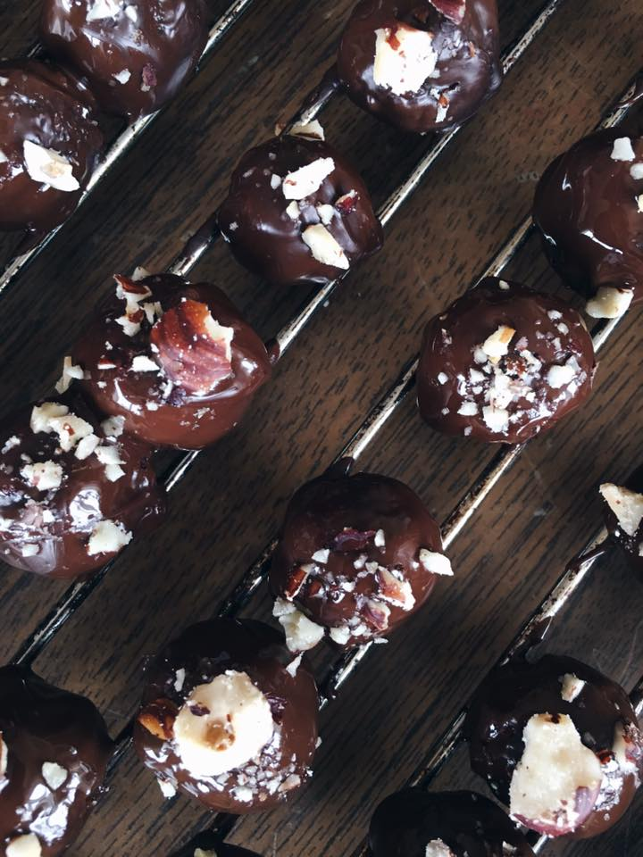
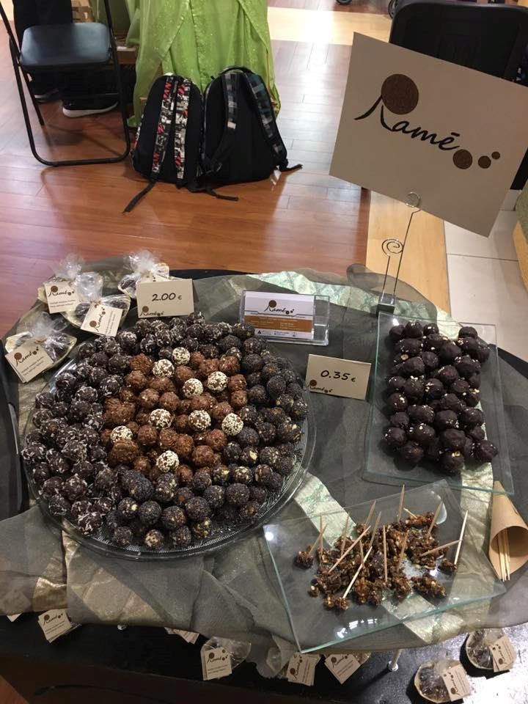
Ramē products

Slide 9
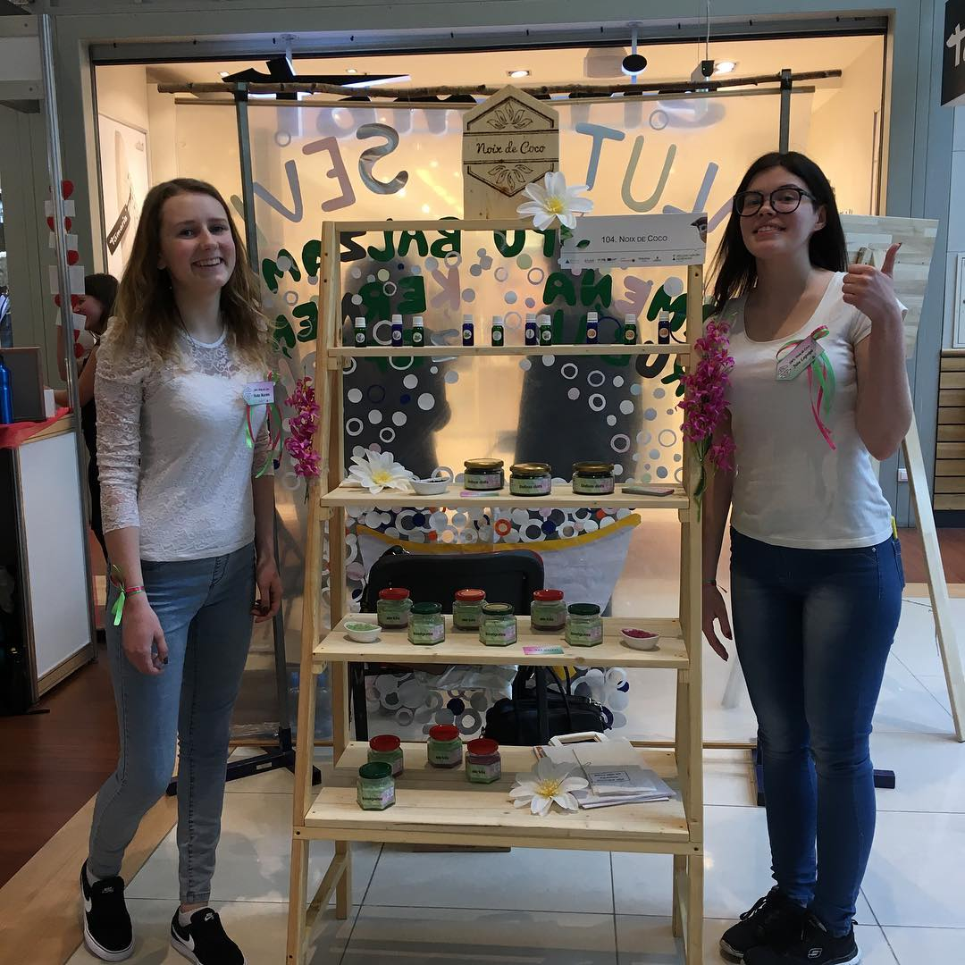
STUDENT COMPANY Noix de Coco
Face and body scrubs and massage oils
Made from coconut oil and other ingredients
Top product - coffee body scrub for sauna

Slide 10
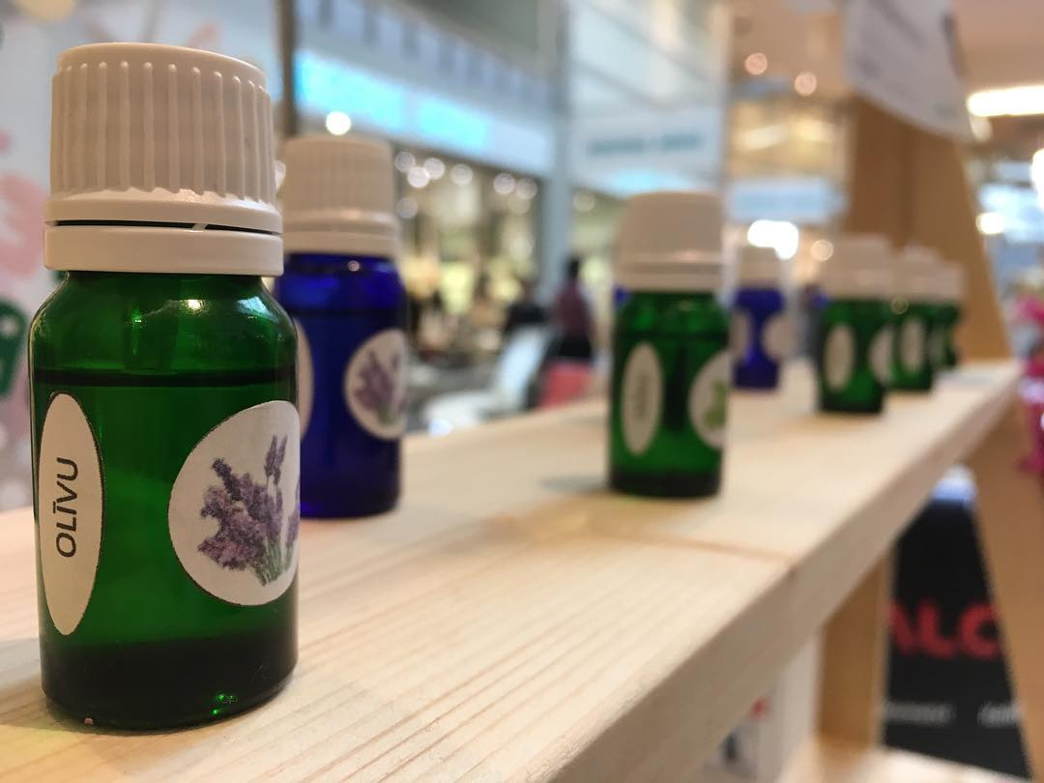
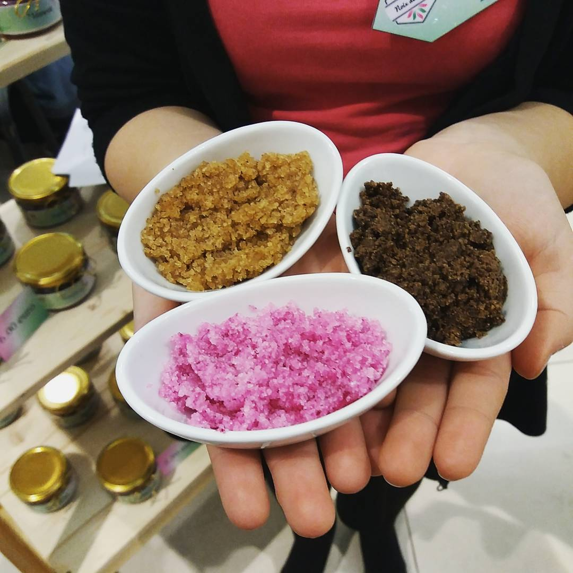
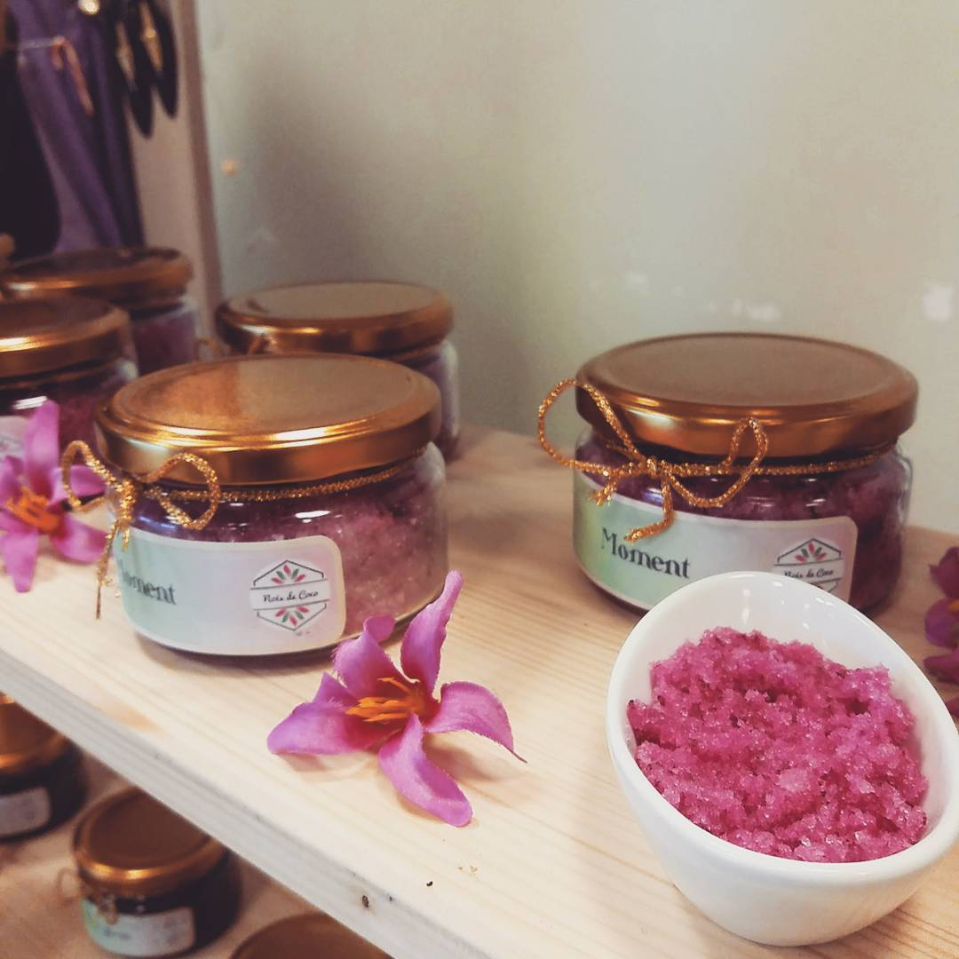
Noix de Coco products

Slide 11
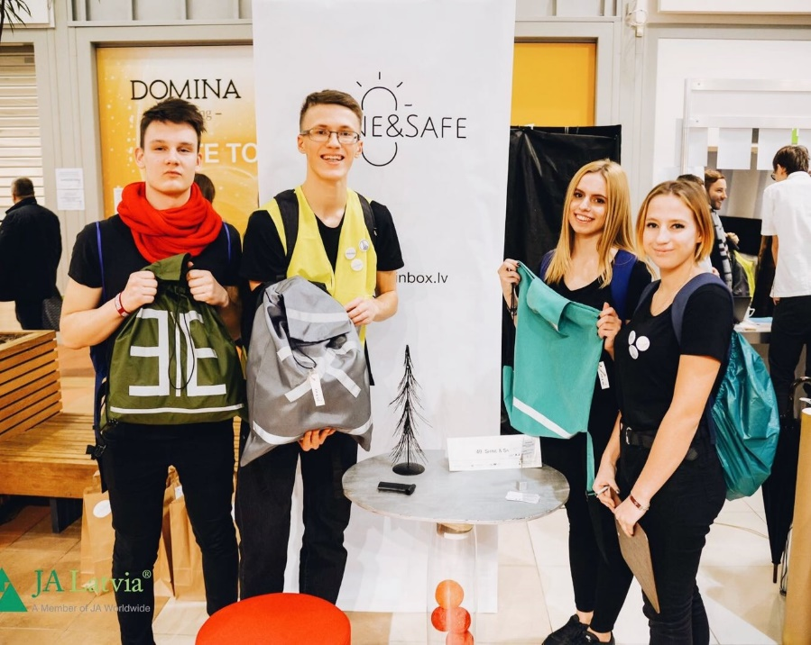
Student company
Shine&Safe
Multifunctional backpack, suitcase covers and sports bags
Water and dust resistant, reflective
1st place in International Student Company Trade Fair

Slide 12
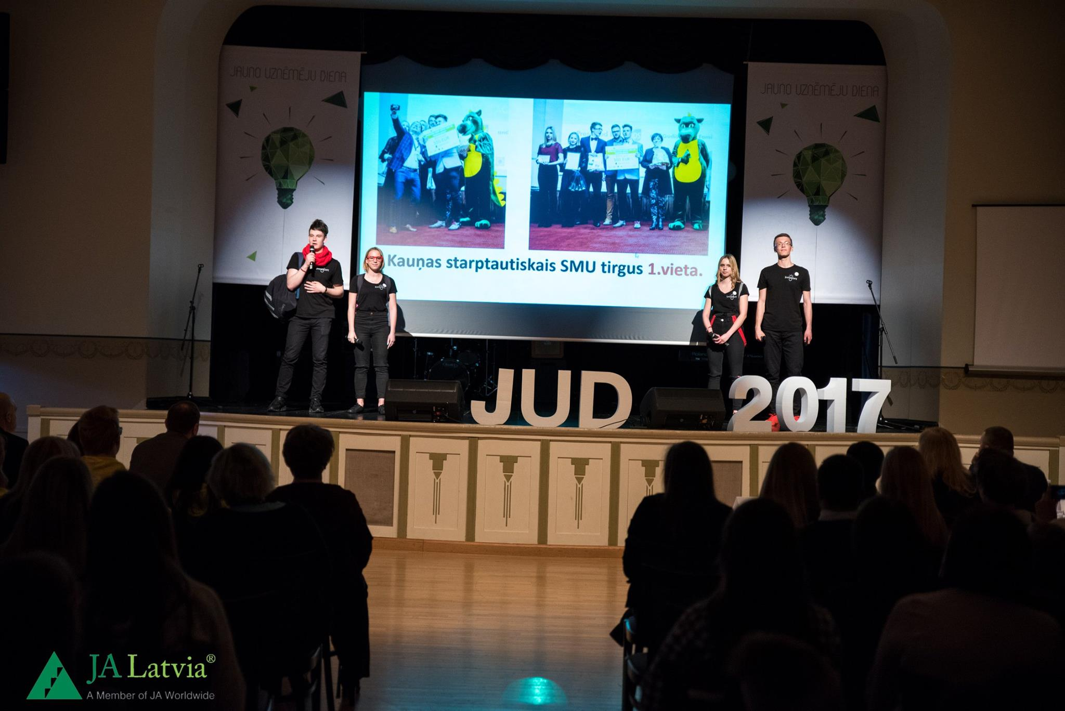
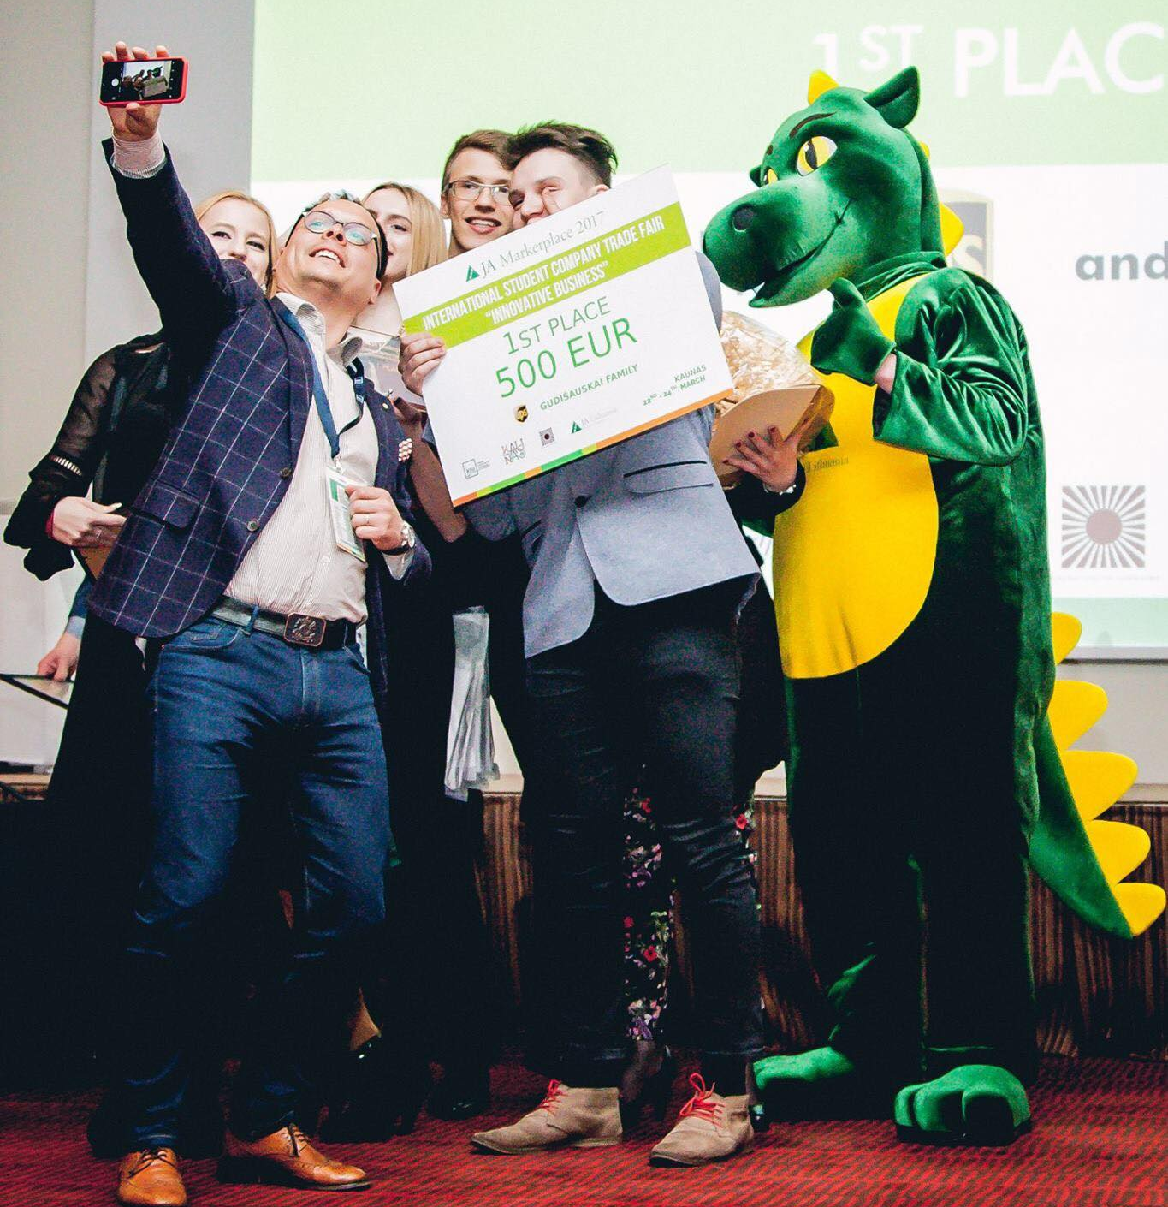
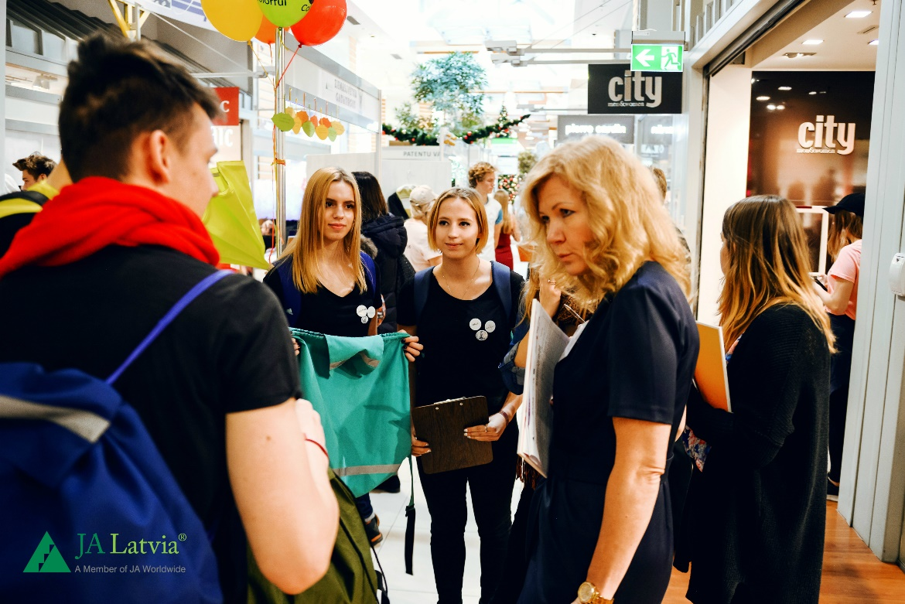
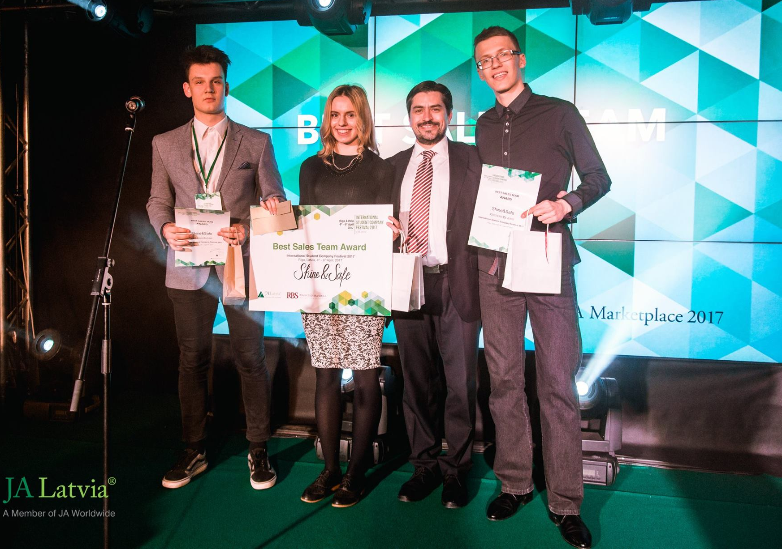

Slide 13
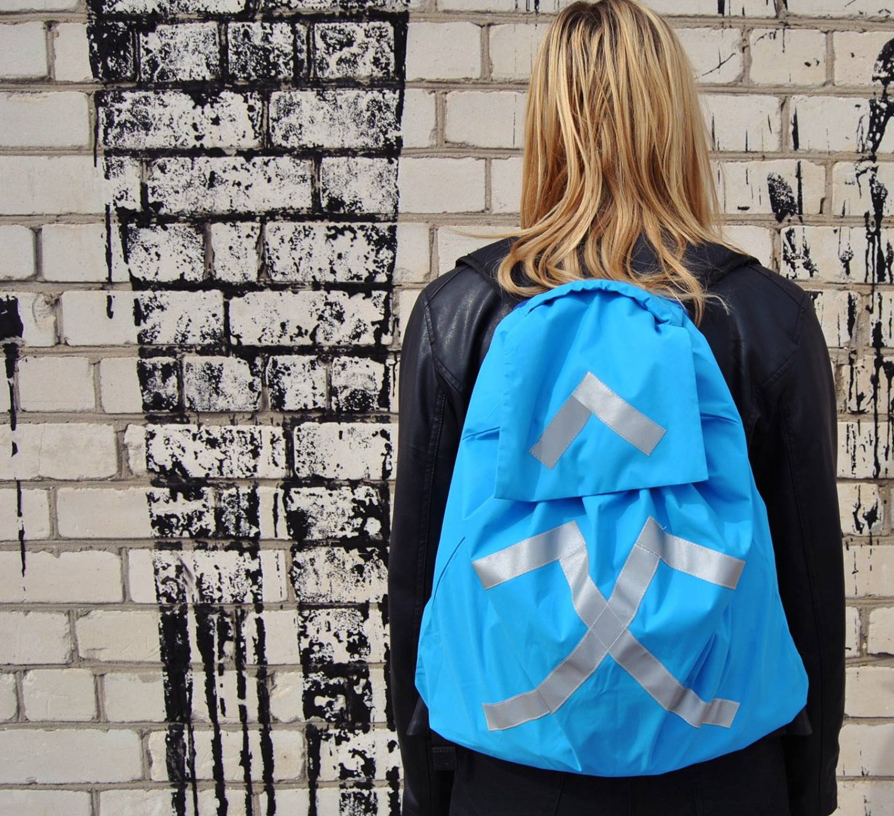
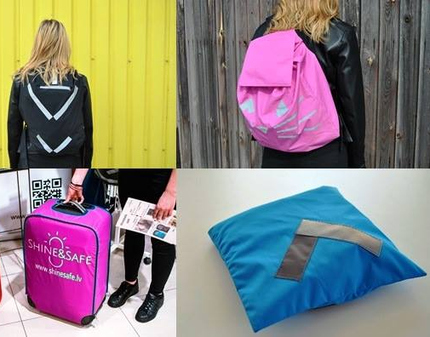
Shine&Safe products

Slide 14
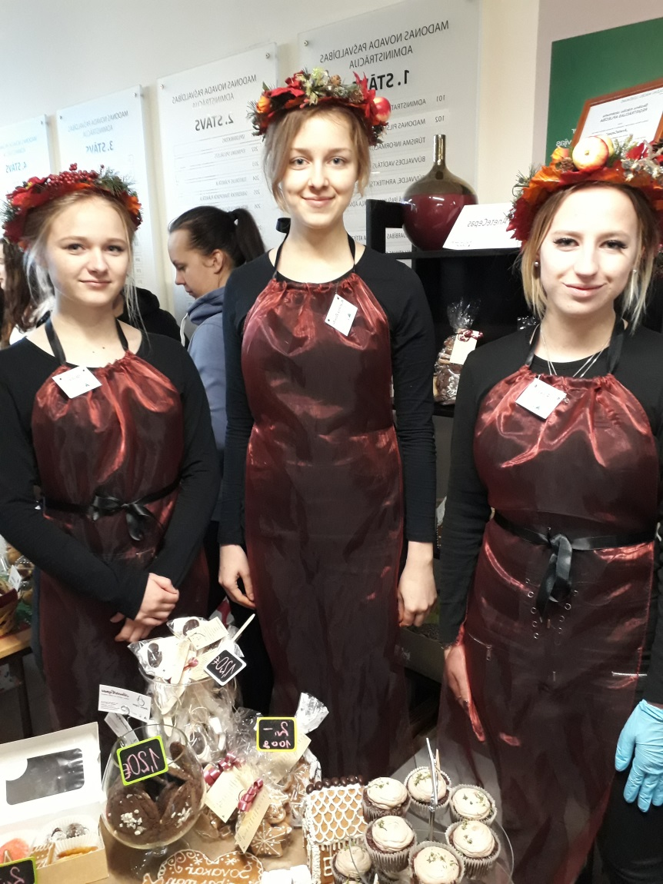
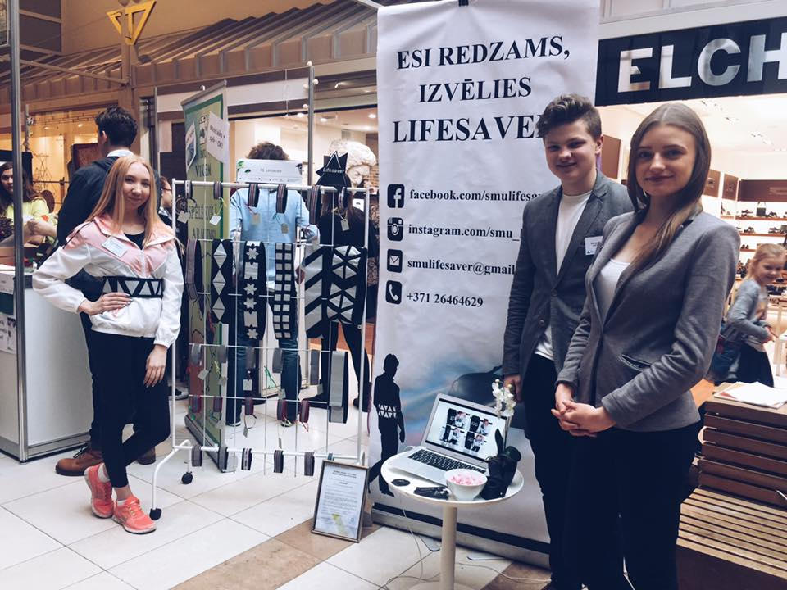
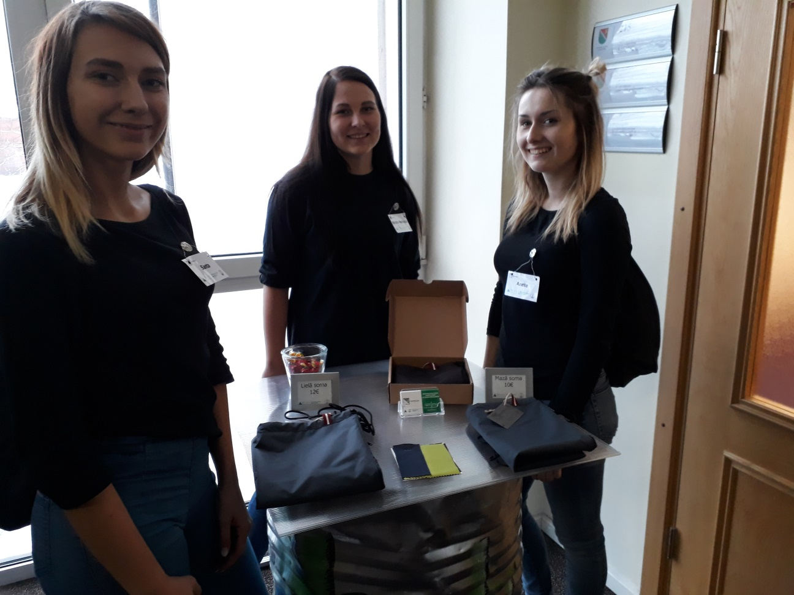
Fairs

Slide 15





INTERNATIONAL PROJECTS

Slide 16


Slide 17
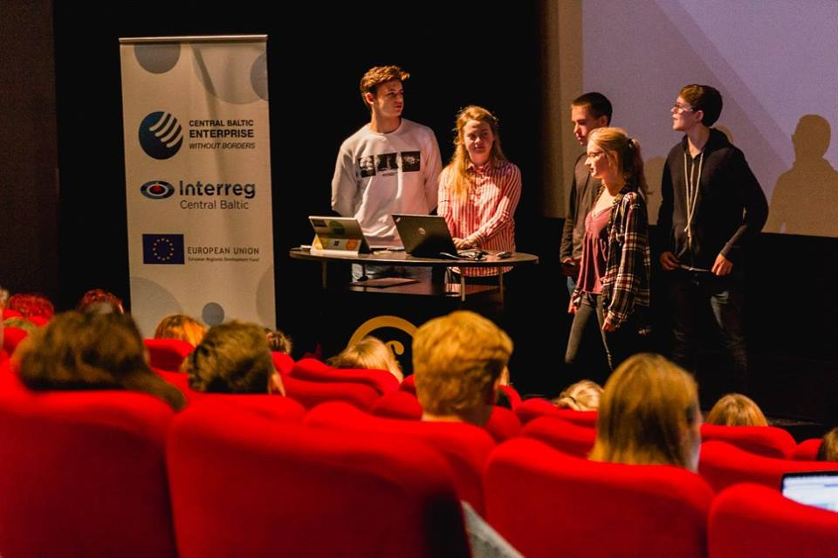
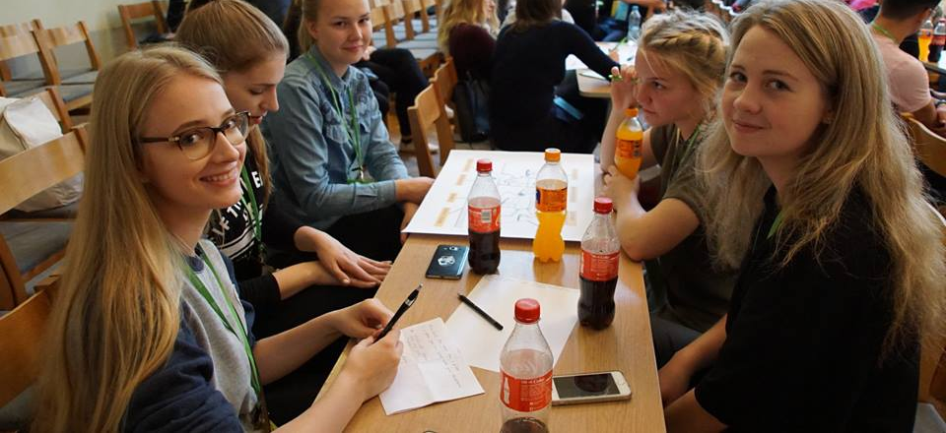
CBEwB – International Student company project
4 student companies
New experience
New friends
New knowledge in
business

Slide 18
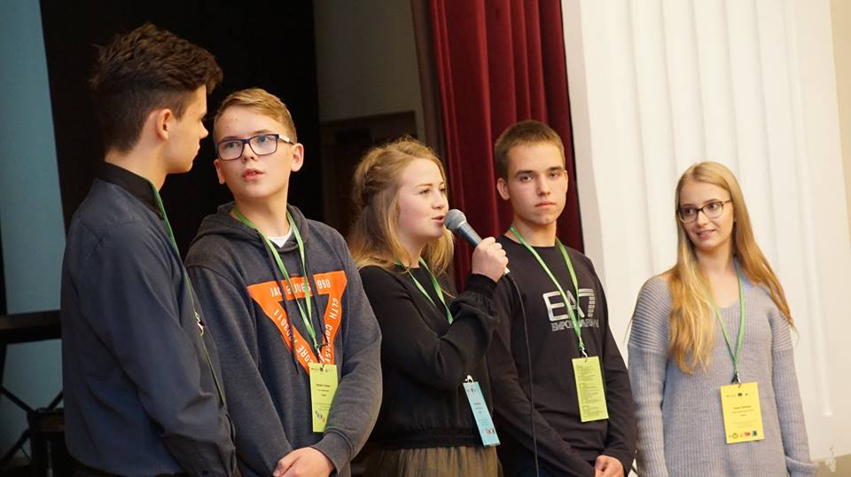
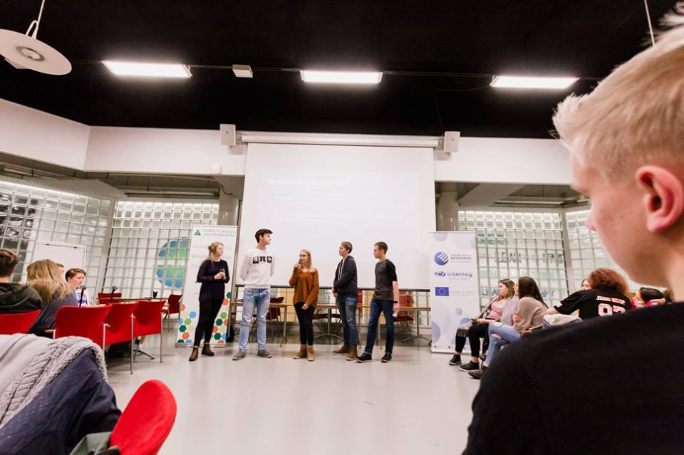

Slide 19
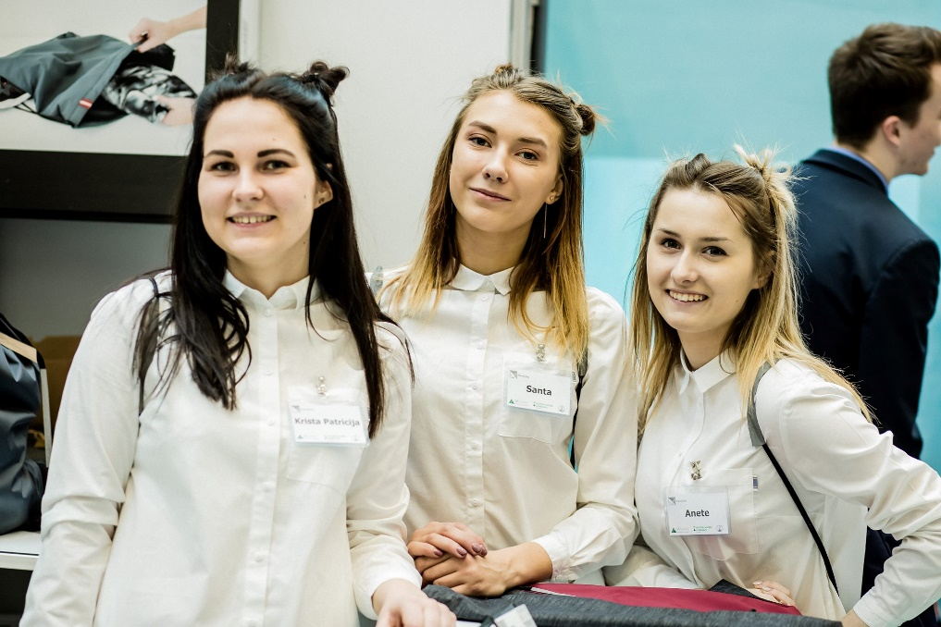
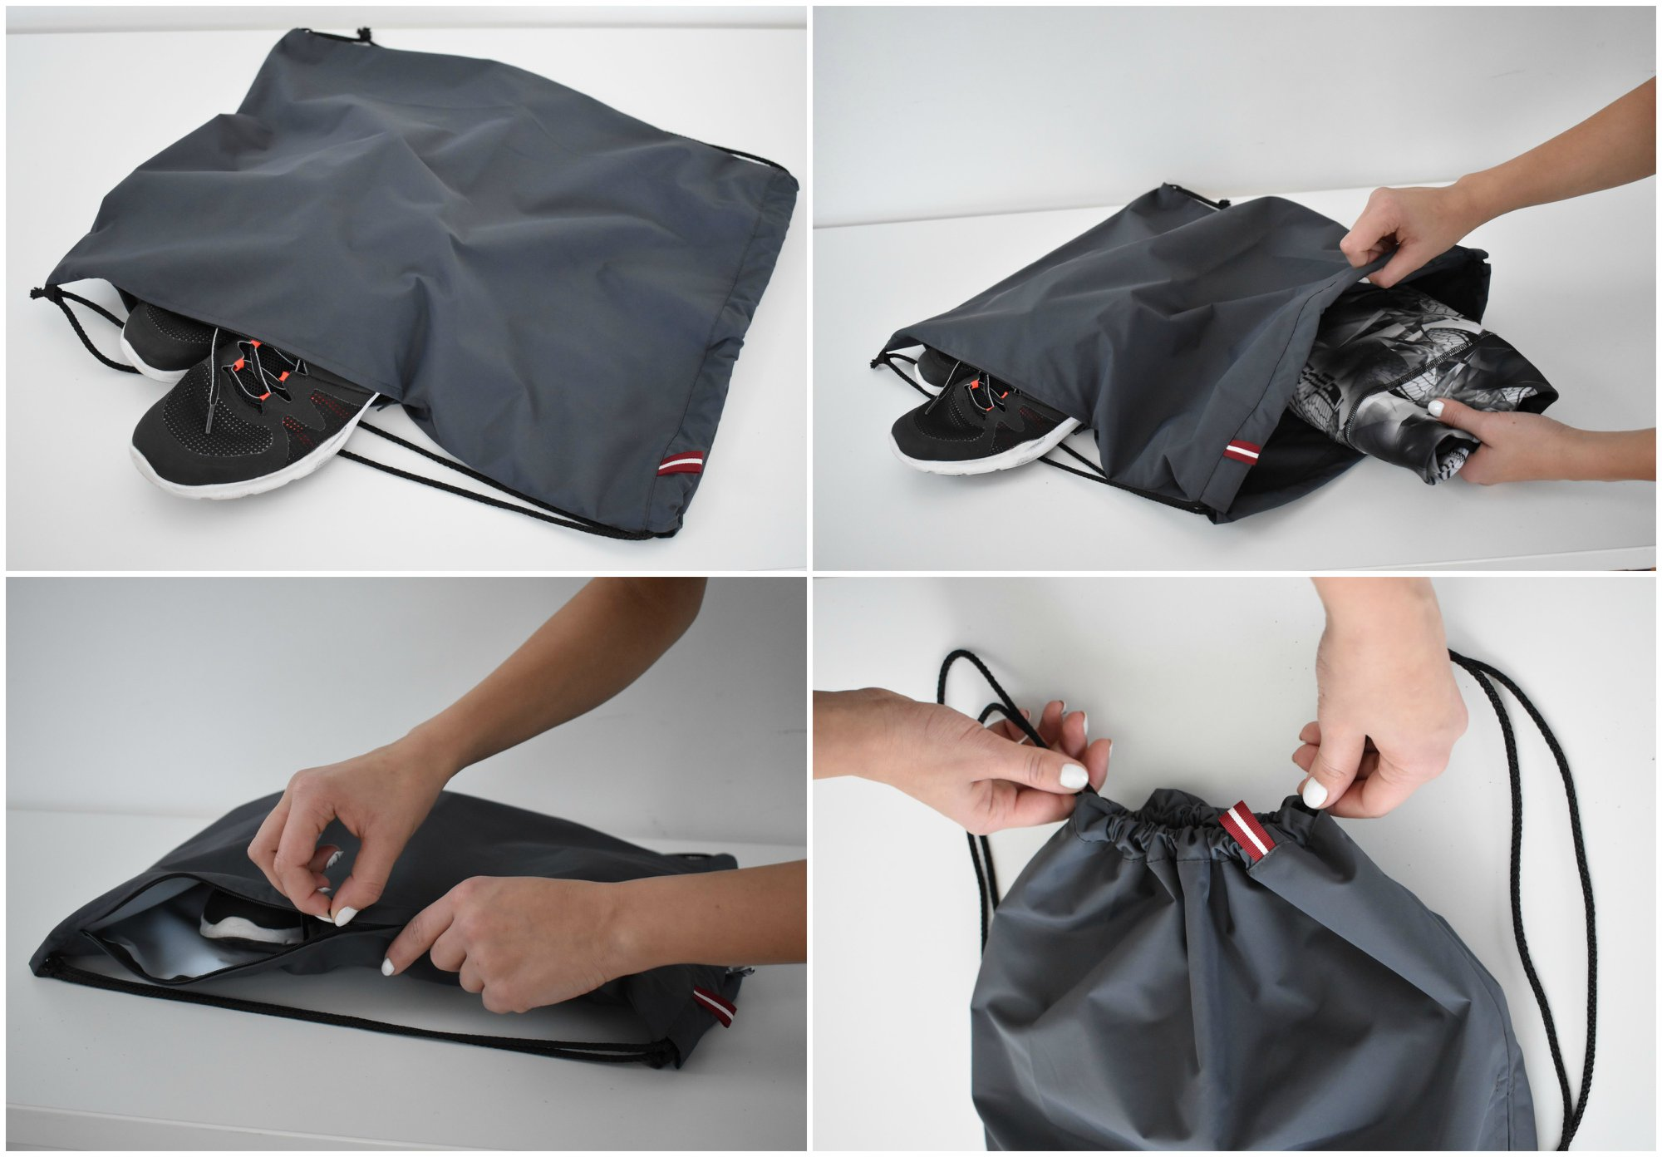
STUDENT COMPANY
‘HandySac’
Sports bags with two pockets
Waterproof, with reflectors on ropes
Specially designed – express Latvian identity, two - colored

Slide 20
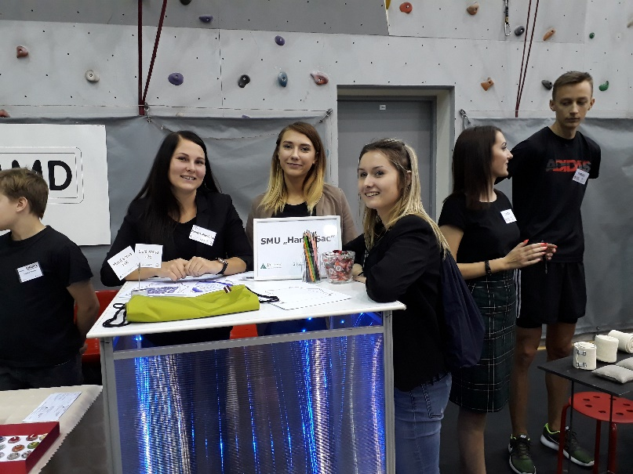
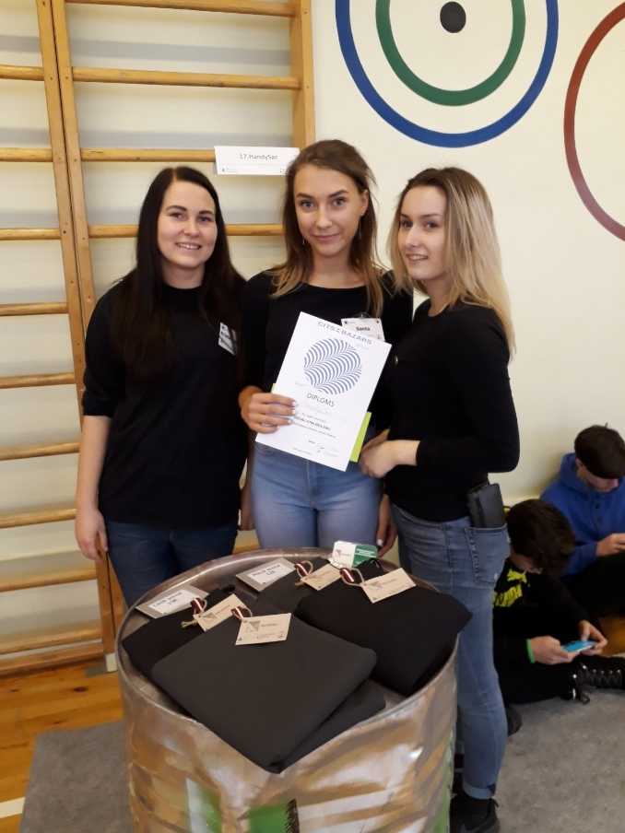
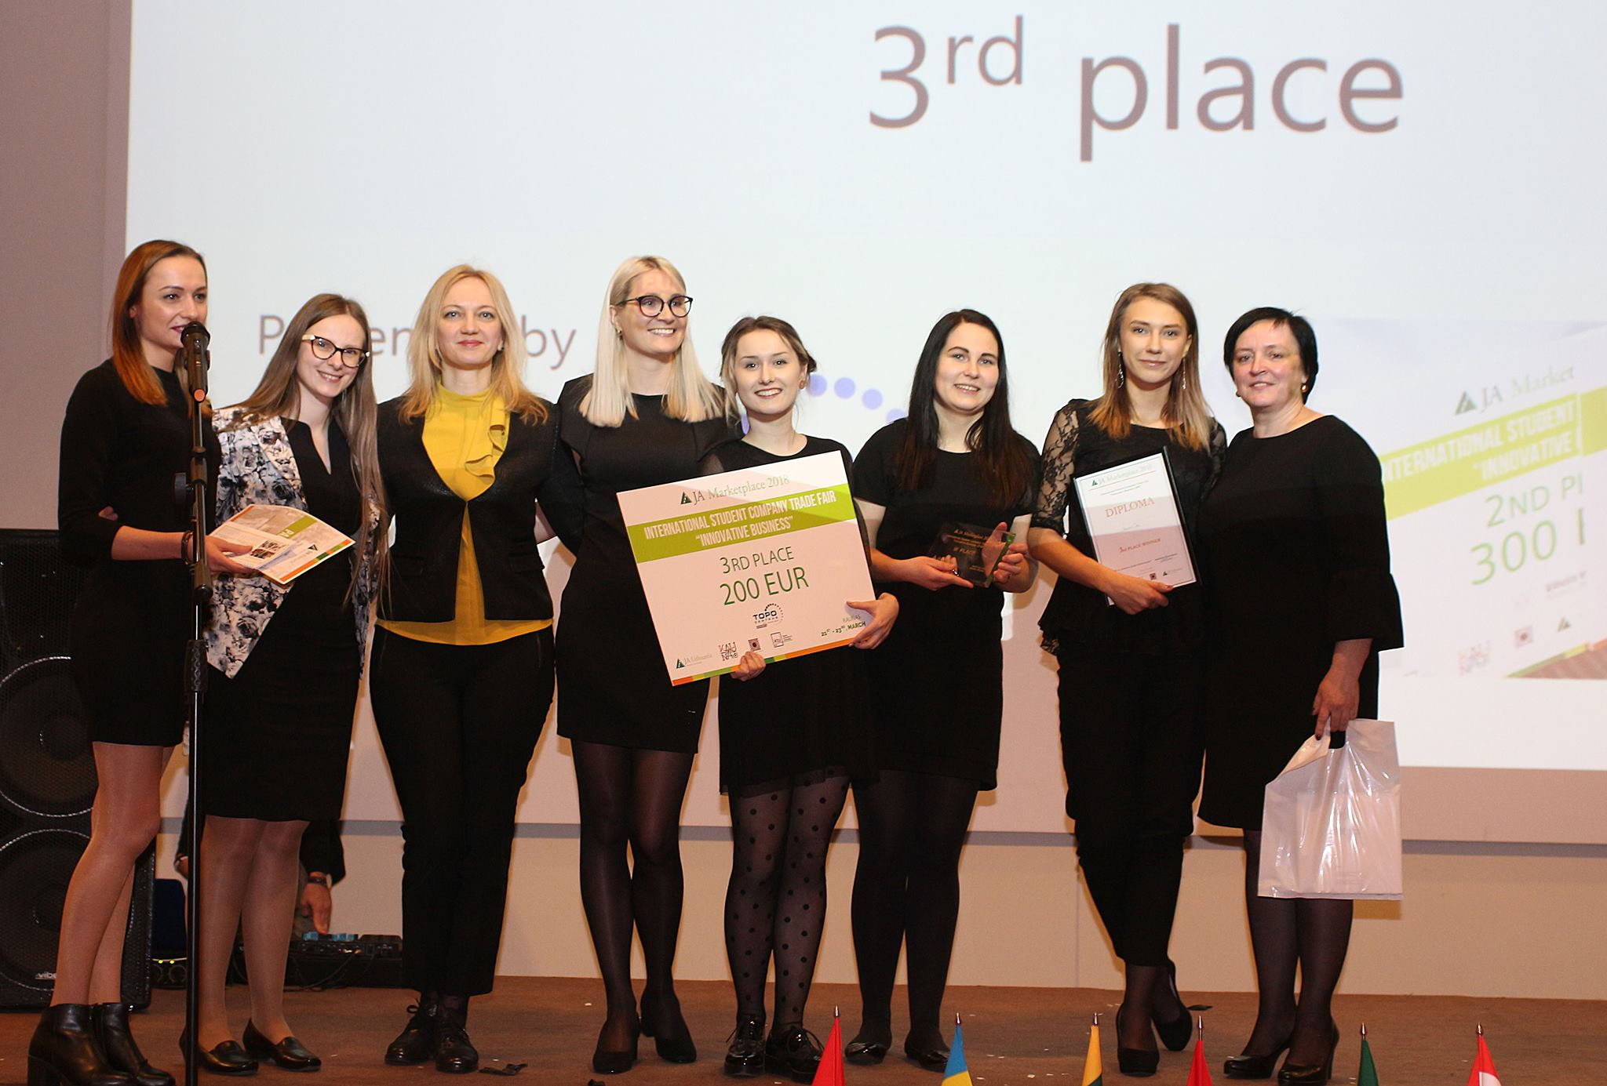

Slide 21

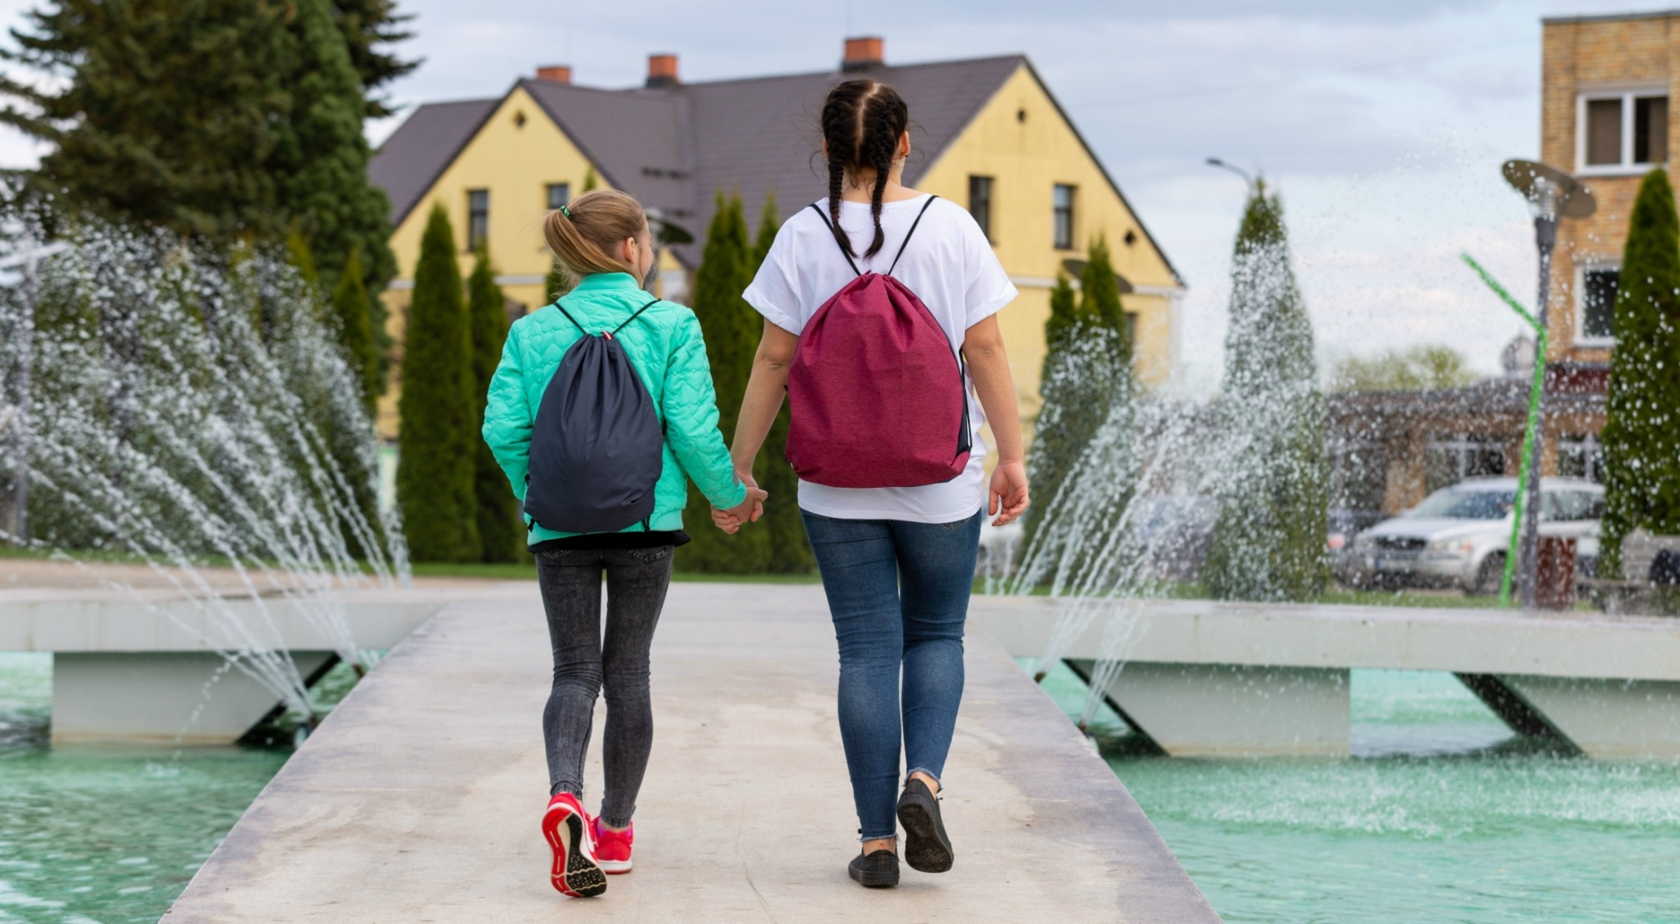

Slide 22
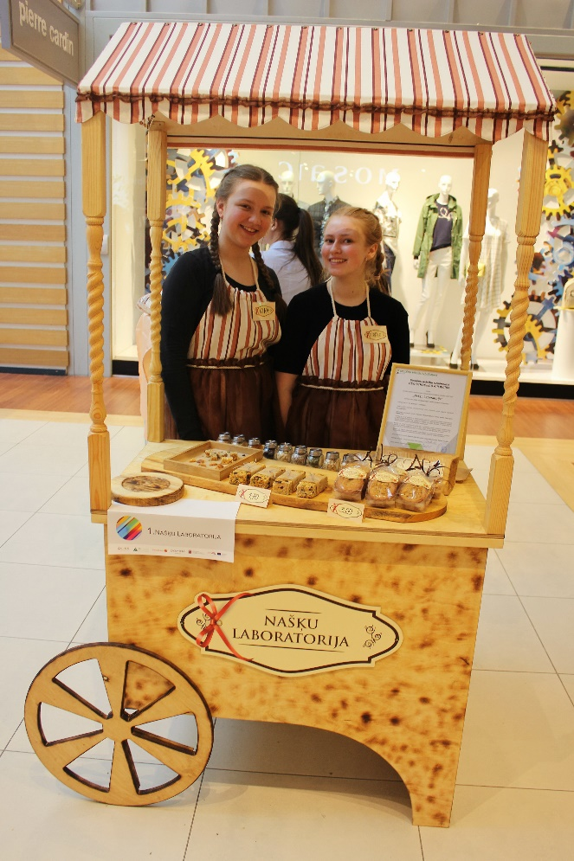
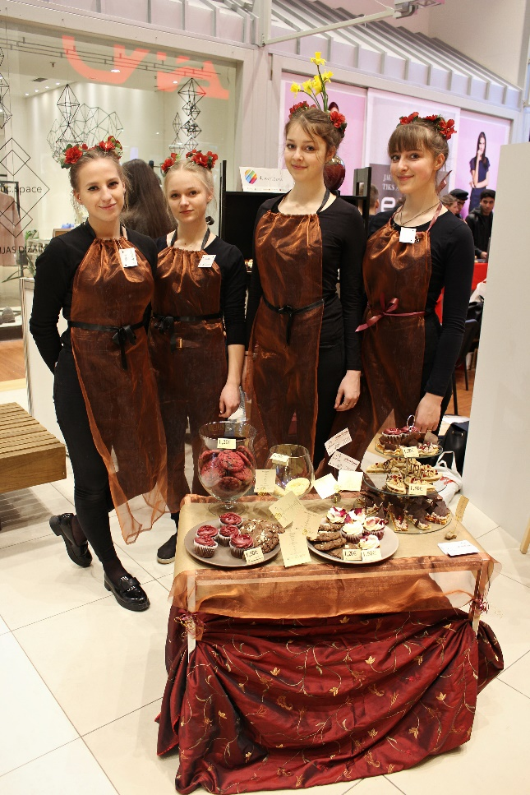
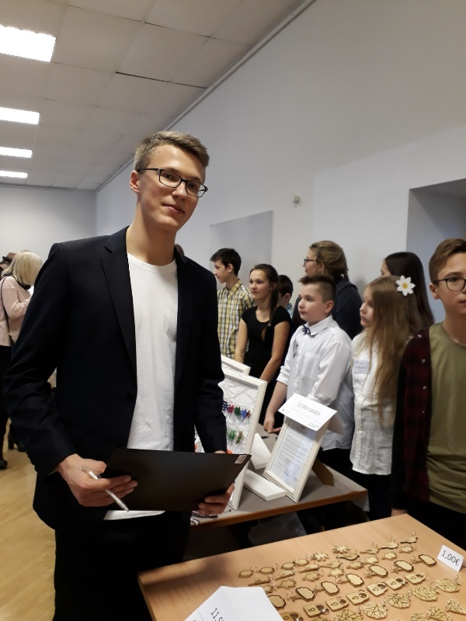
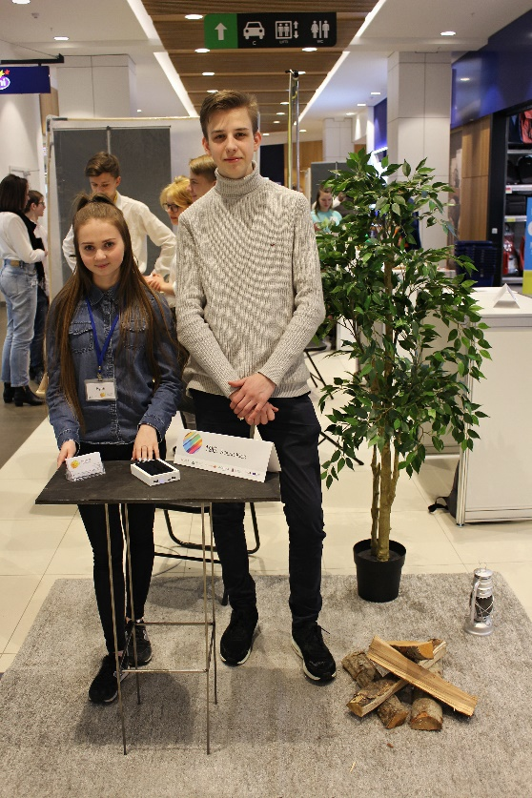
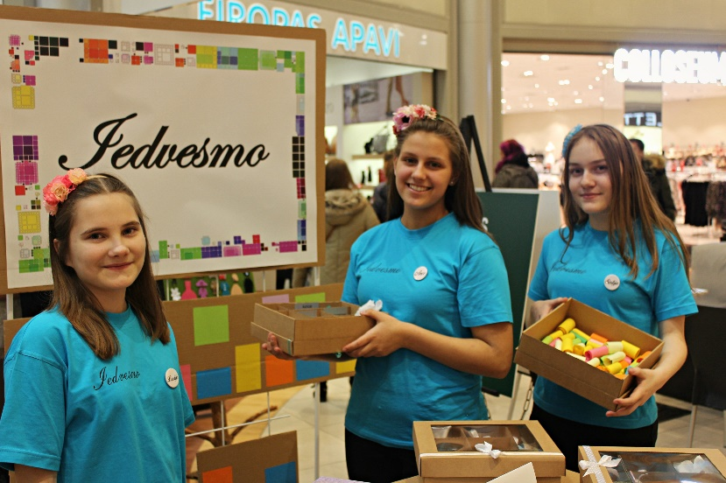
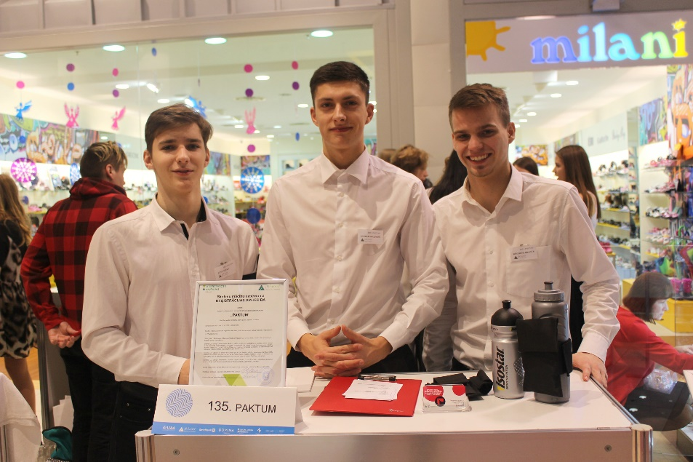
Other student companies from our school

Slide 23
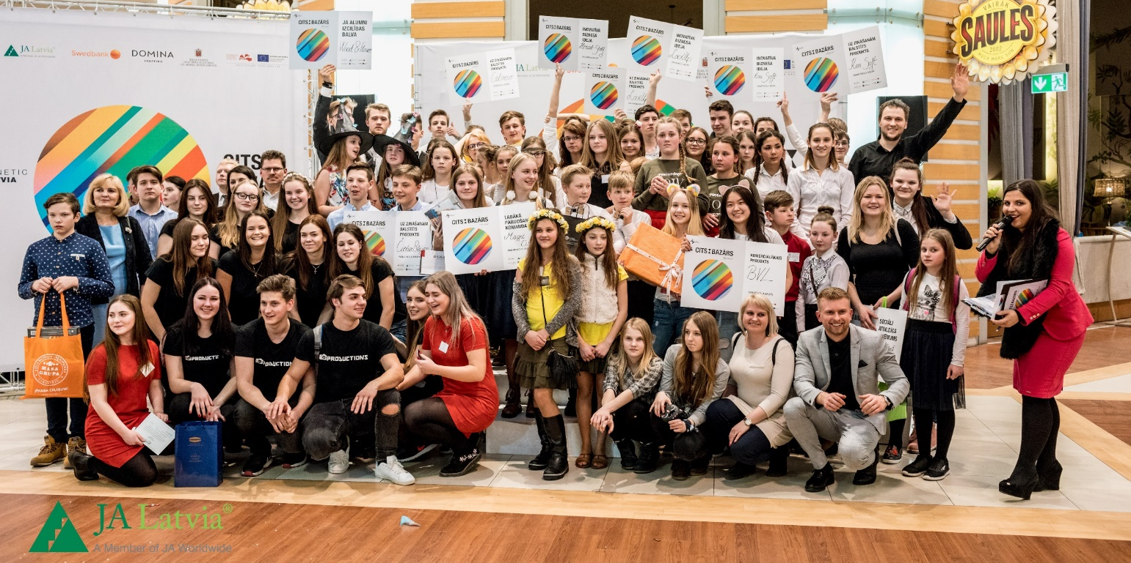
Erasmus+ summary
Total amount of student companies during this project: 12
Total amount of students that made student companies: 9
Total amount of trade fairs students participated in: 17

Slide 24

THANK YOU FOR YOUR ATTENTION

